Slide 1
Homeless People
Management System
Group Member:
Mengting Yang
Chiwen Shi
Zhao Jin

Slide 2
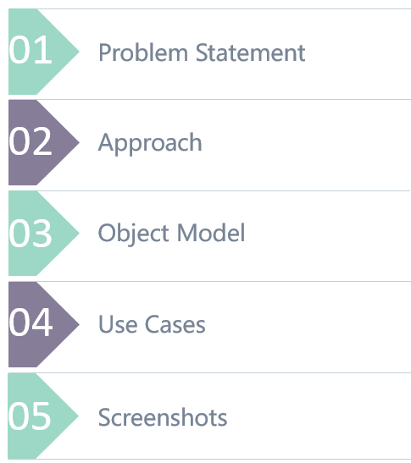
Contents

Slide 3
Part One: Problem Statement

Slide 4
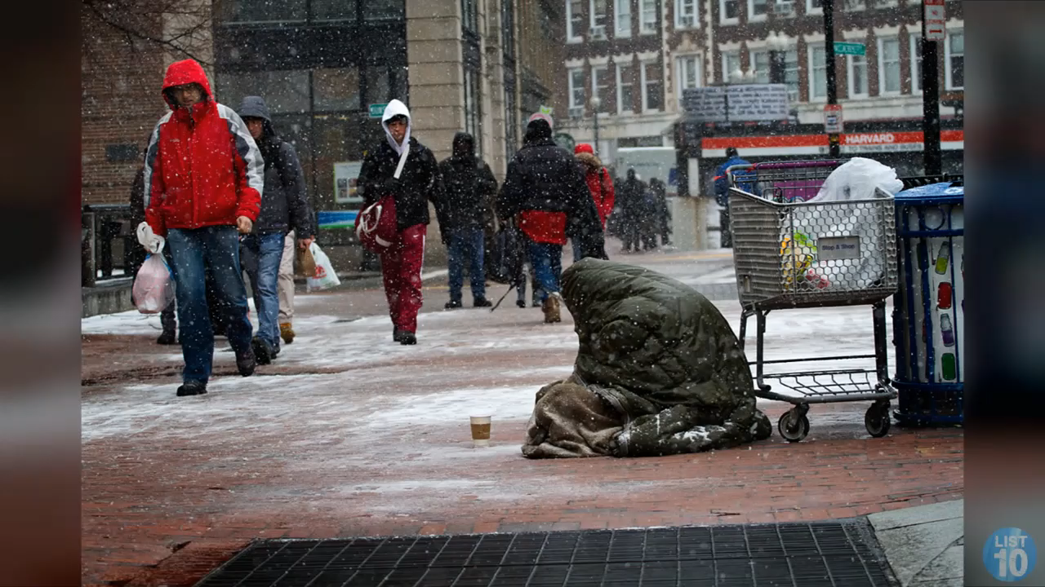
Problem Statement
From this video, we can know that how to help homeless people find shelters is an urgent problem to be solved. It is of great significance for us to come up with a plan to help end homelessness. This is the objective of our project.

Slide 5
Problem Statement—Social Value
点击此处添加标题
What causes homelessness?
Please click here to add the required titles
People become homeless for lots of different reasons. There are social causes of homelessness, such as a lack of affordable housing, poverty and unemployment; and life events which cause individuals to become homeless. Many people become homeless because they can no longer afford the rent.
1
2
3
Improve Resource Utilization
Control Infectious Diseases
Reduce Crime Rates
Our system helps the homeless people to find shelters from spare spaces of library, church and so on. This can improve the resource utilization to a great extent.
We provide physical examination for every homeless people, in this way can we control the infection rate of diseases.
Once we find shelters for homeless people, the crime rates can be reduced, it has great value for social security.

Slide 6
Part Two: Approach

Slide 7
Approach
点击此处添加标题
Please click here to add the required titles
01
Find shelters for homeless people
We found there are a lot of spaces which are free in some specific time slots. For example, the church will close in the evening and there will be spare spaces in it. So what we think is to make good use of such spaces to help homeless people find shelters.
What we do?
02
Monitor the physical health problems of homeless people
There is an organization named hospital that monitors the physical health status of homeless people. We can not only help the homeless people find shelters, but also can track their physical status to help them get vaccination.

Slide 8
Part Three: Object Model

Slide 9
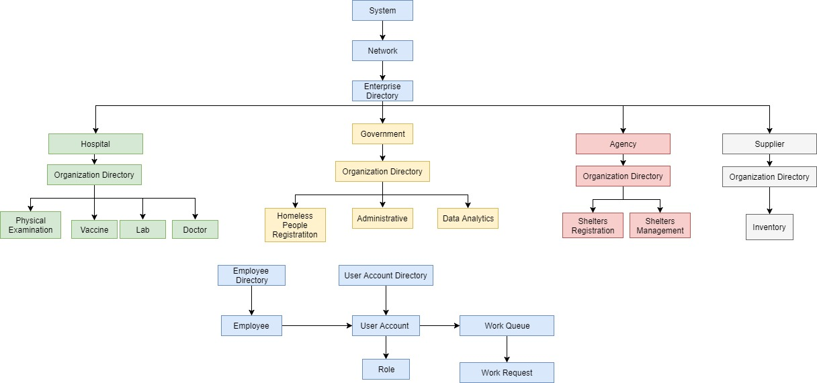
Object Model

Slide 10
Part Four: Use Cases

Slide 11
Use Cases
点击此处添加标题
Please click here to add the required titles
Government
Supplier
Register for homeless people
Send Request to Agency to ask them to find allocate shelters for homeless people.
Data Analysis.
Manage disease catalog and vaccine catalog.
Provide vaccines for hospitals.
Government
Agency
Supplier
Agency
Hospital
Hospital
Allocate shelters for homeless people according to the request sent by government.
Register for new available shelters.
Physical Examination Role collect (blood) sample for homeless people.
Lab Assistant test the sample and give the examination result for homeless people.
Doctor give diagnosed result to nurse.
Nurse take vaccination for every homeless people according to the diagnosis made by doctor.

Slide 12
Part Five: Screenshots

Slide 13
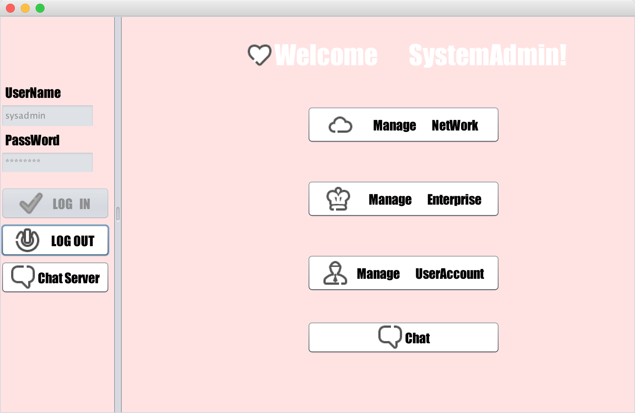
Screen Shots

Slide 14
Screen Shots
Supplier Role

Slide 15
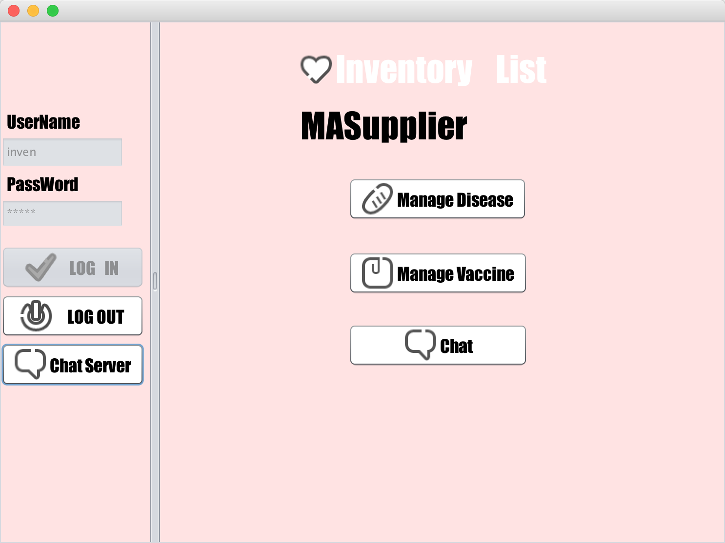
Screen Shots

Slide 16
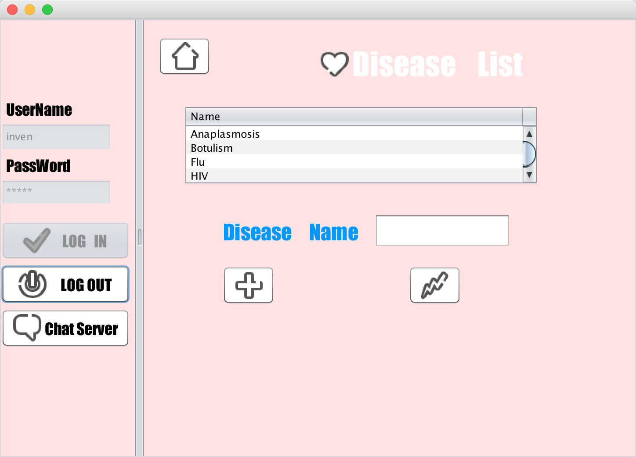
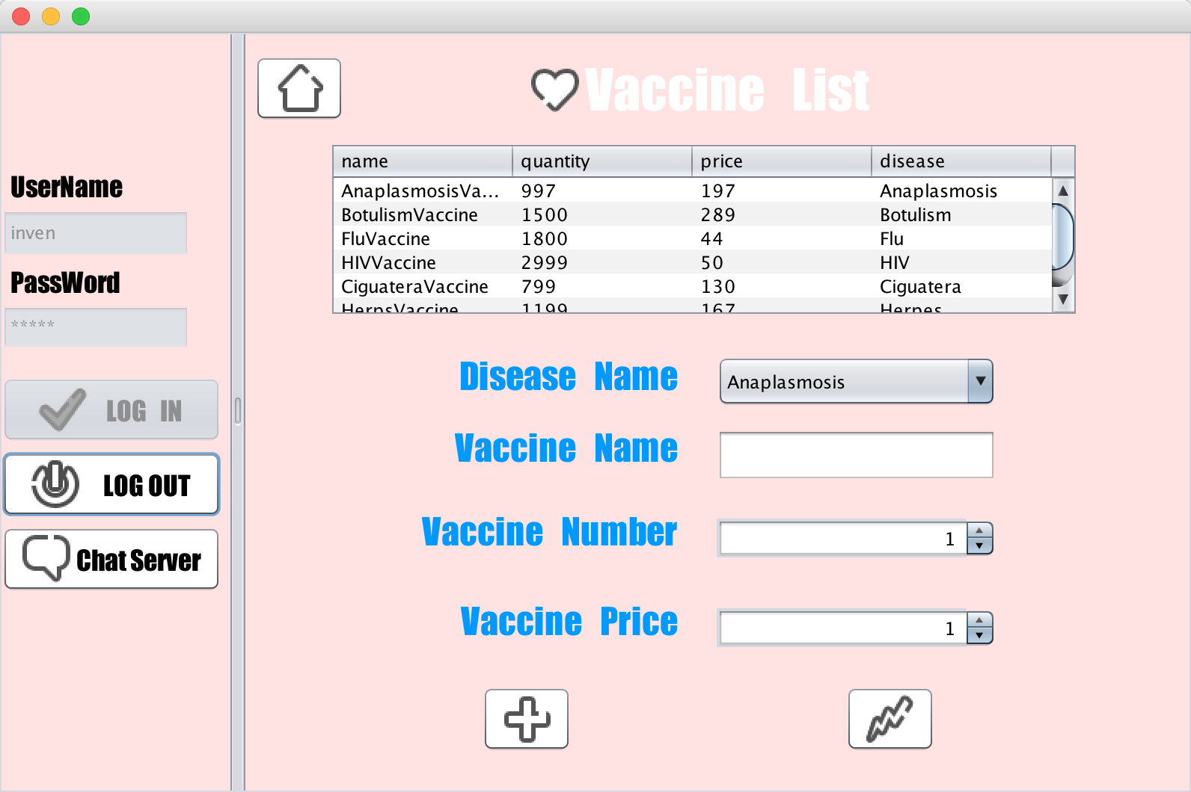
Screen Shots

Slide 17
Screen Shots
Homeless People Role

Slide 18
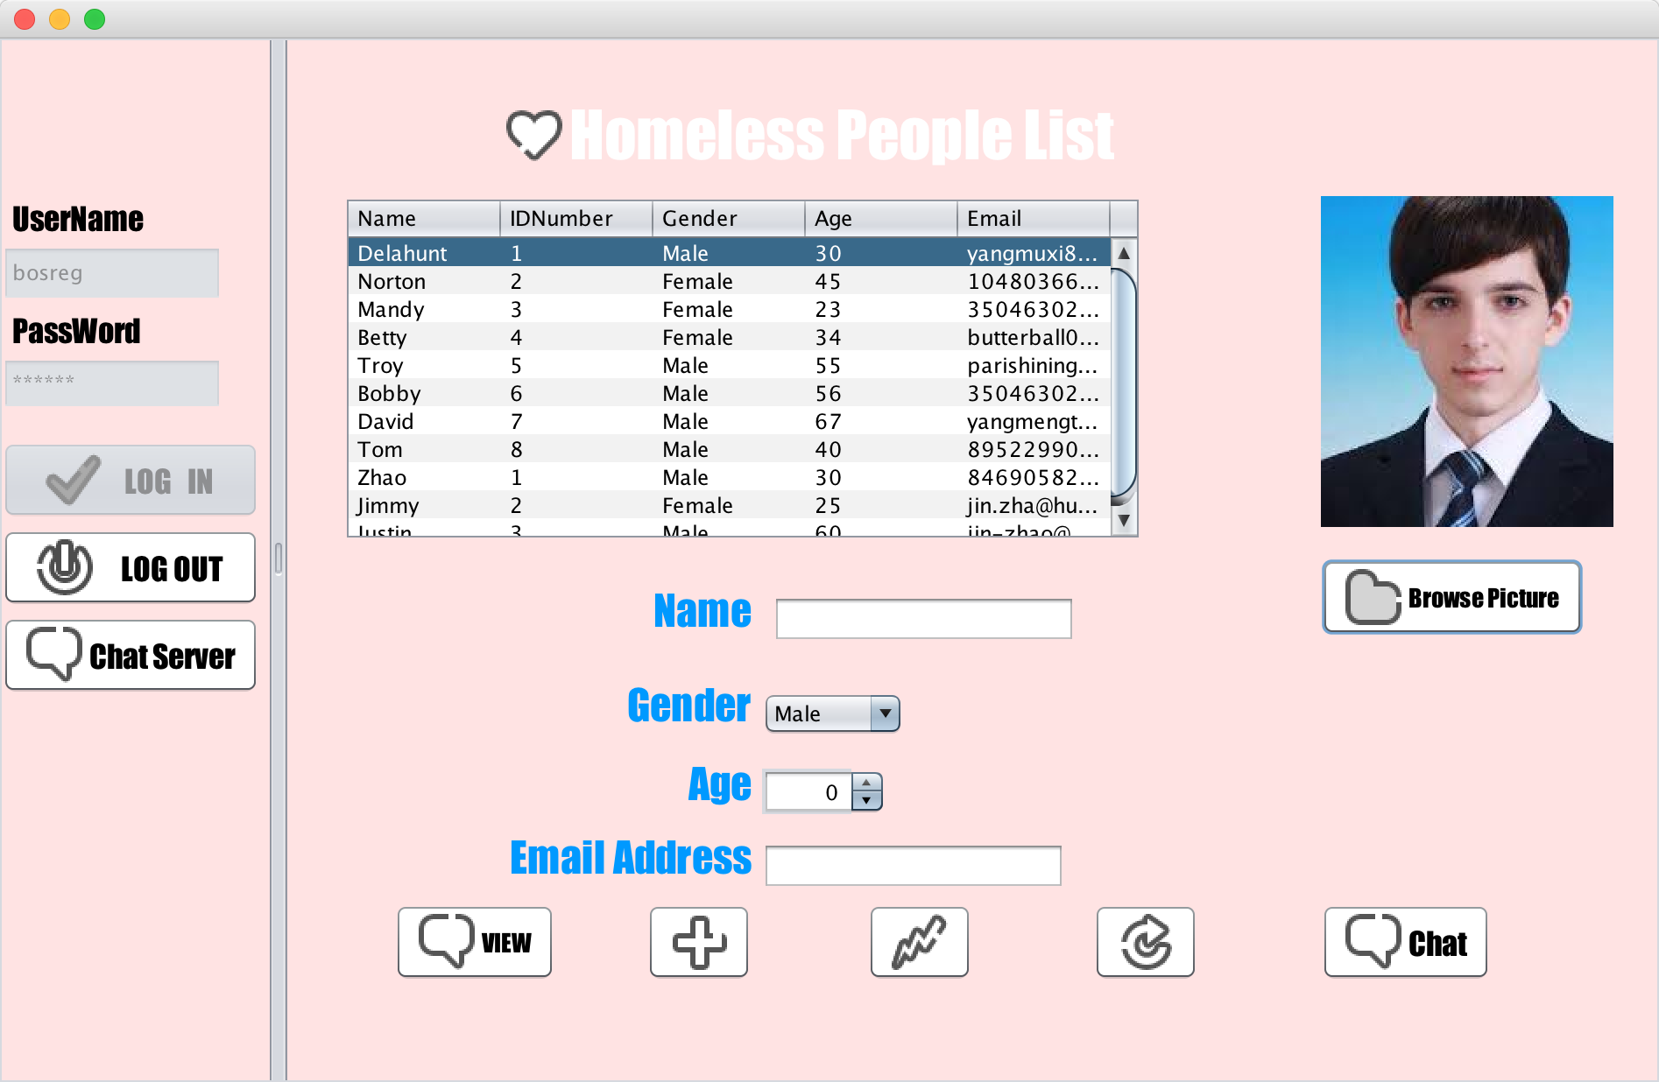
Screen Shots

Slide 19
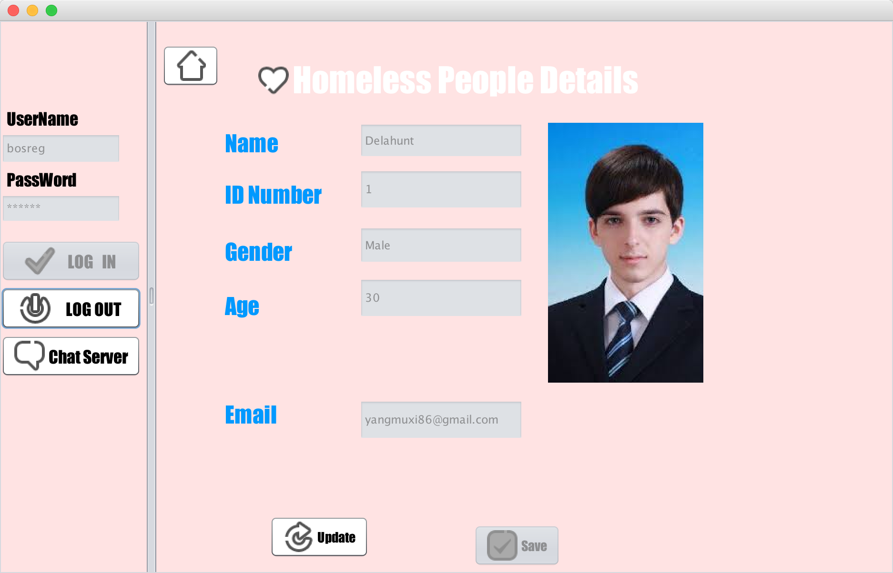
Screen Shots

Slide 20
Screen Shots
Shelter Registration Role

Slide 21
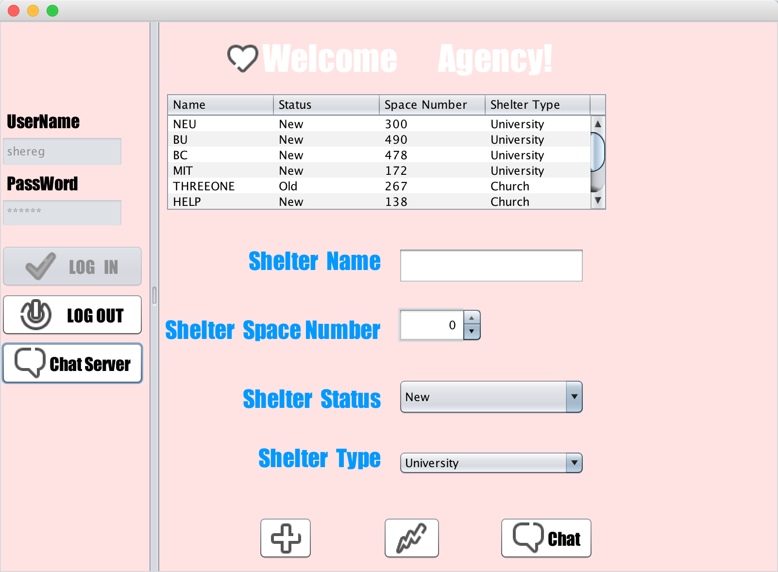
Screen Shots

Slide 22
Screen Shots
Government Admin Role

Slide 23
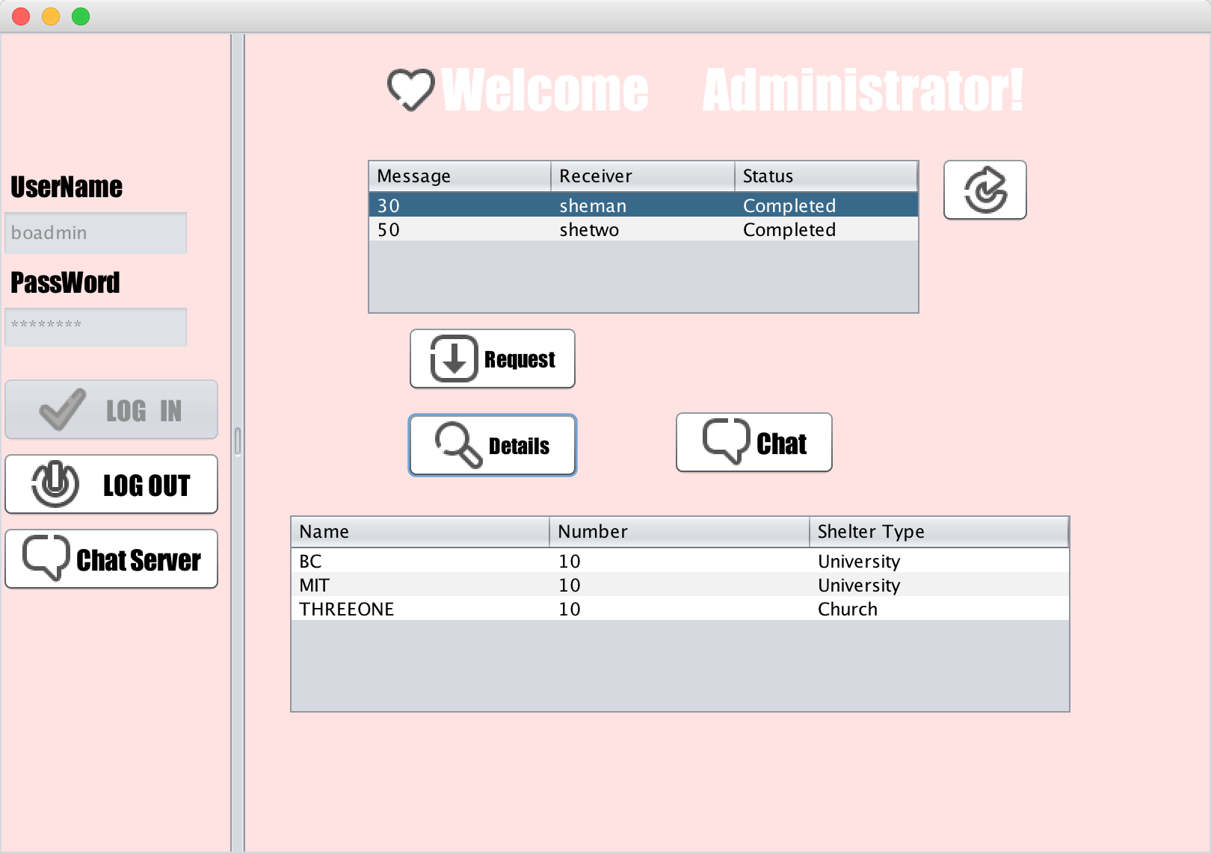
Screen Shots

Slide 24
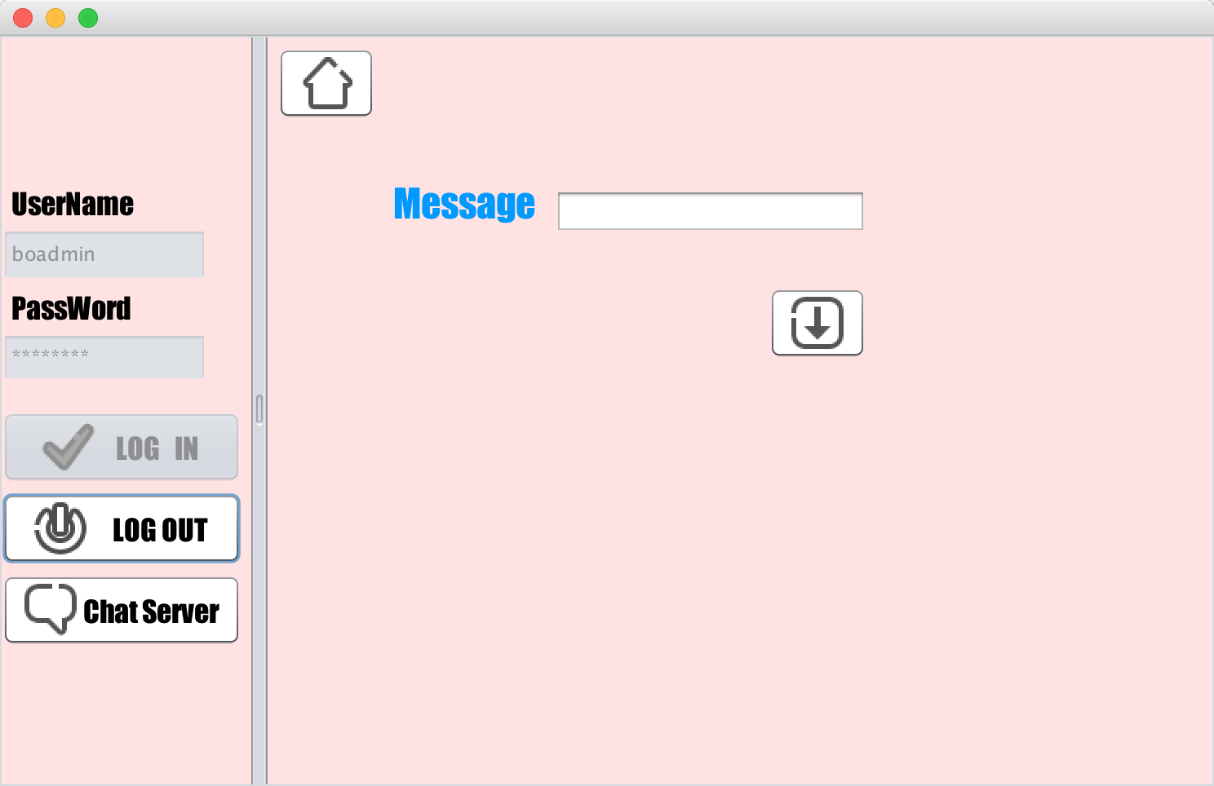
Screen Shots

Slide 25
Screen Shots
Agency Management Role

Slide 26
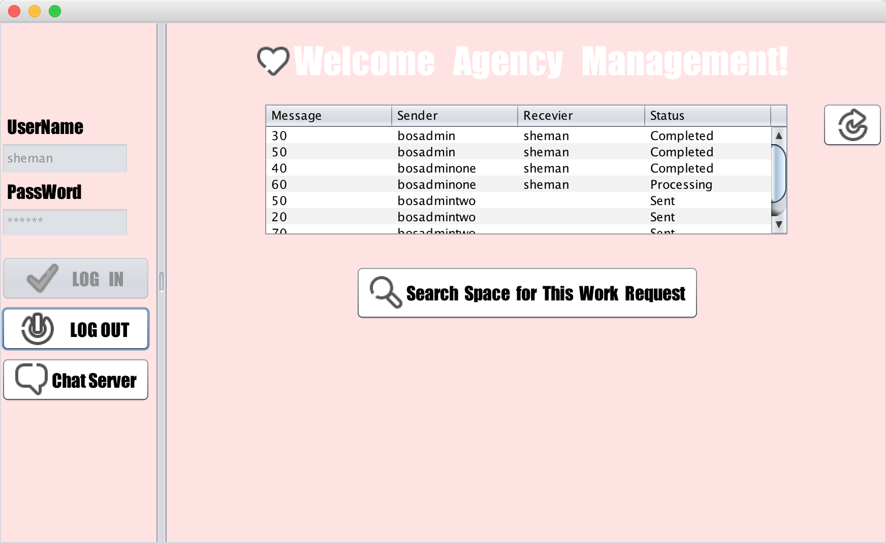
Screen Shots

Slide 27
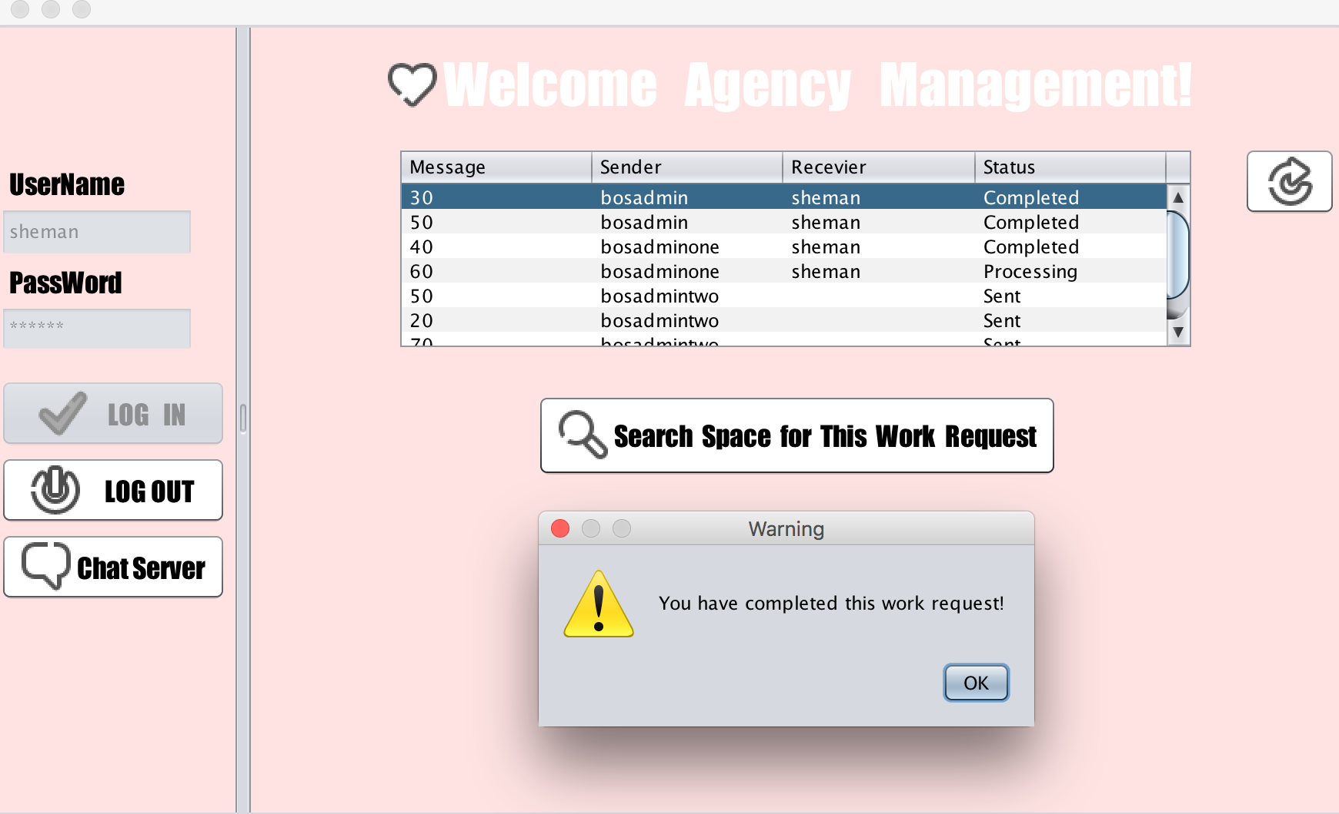
Screen Shots

Slide 28
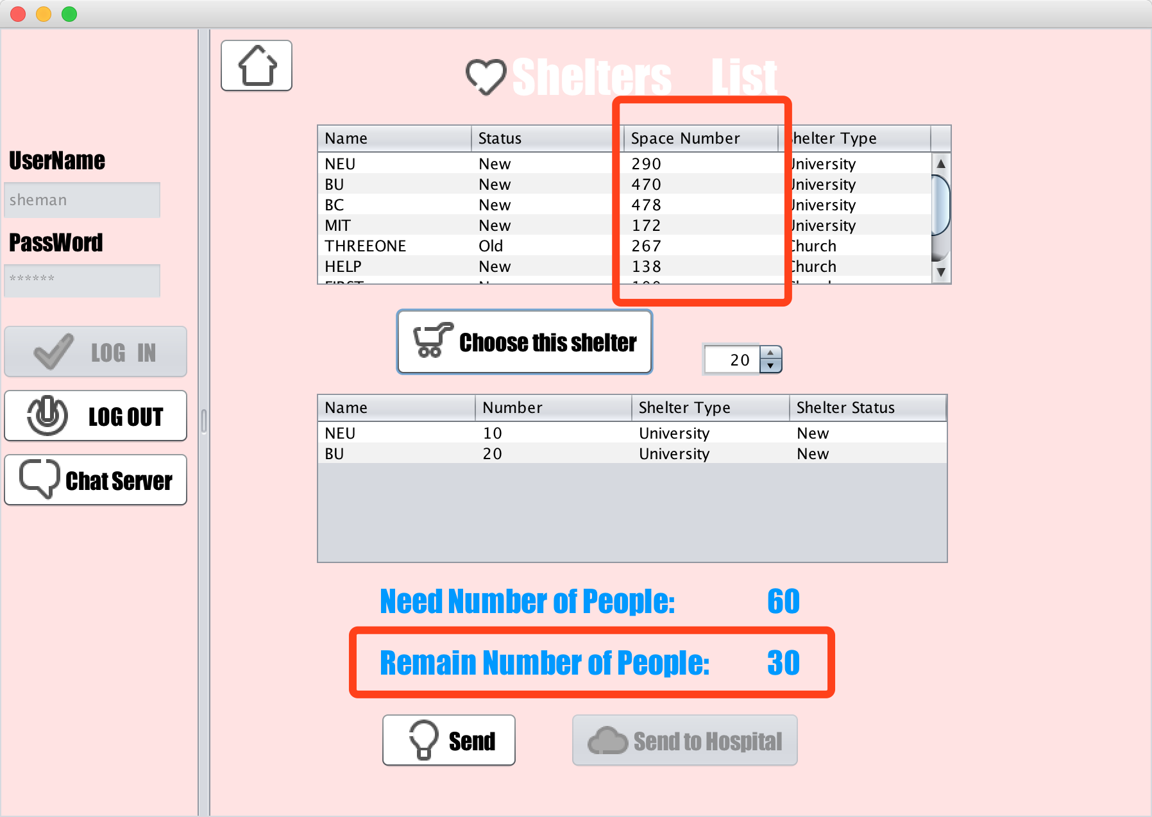
Screen Shots

Slide 29
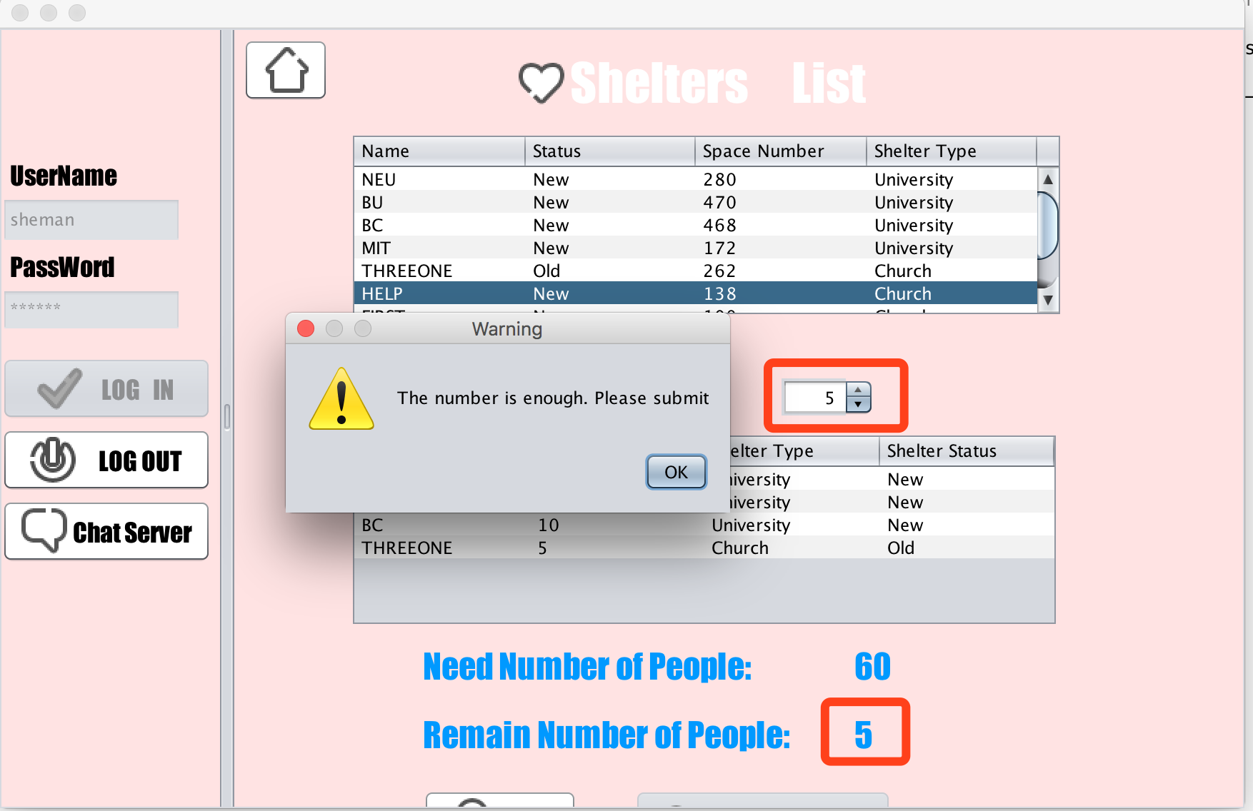
Screen Shots

Slide 30
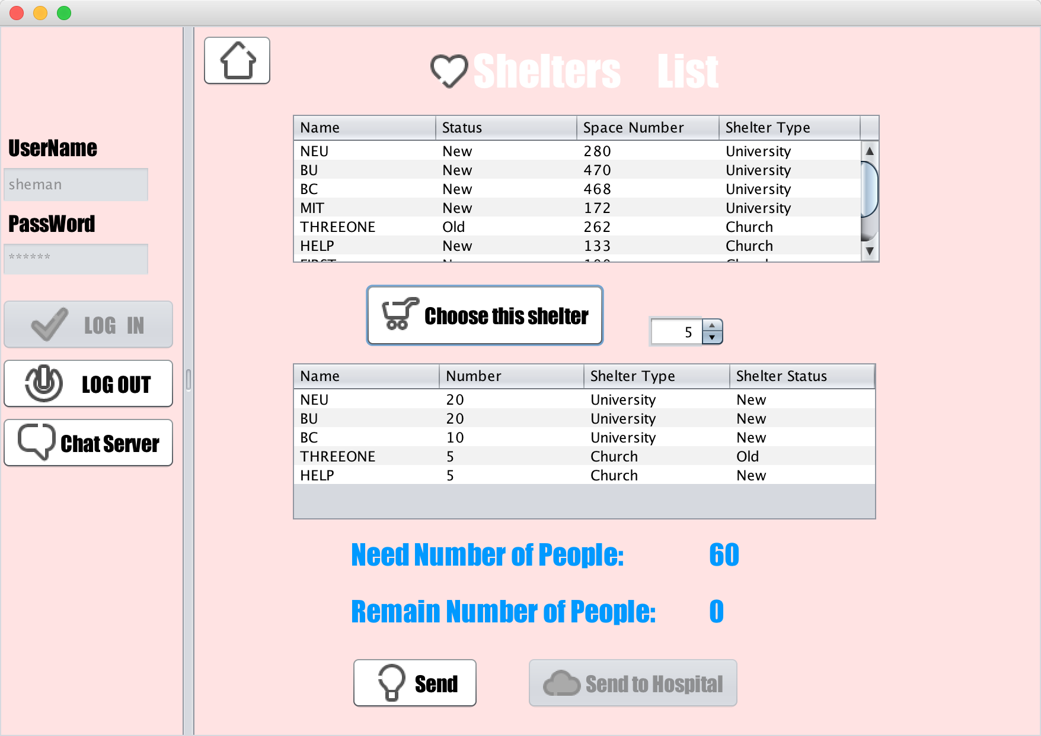
Screen Shots

Slide 31
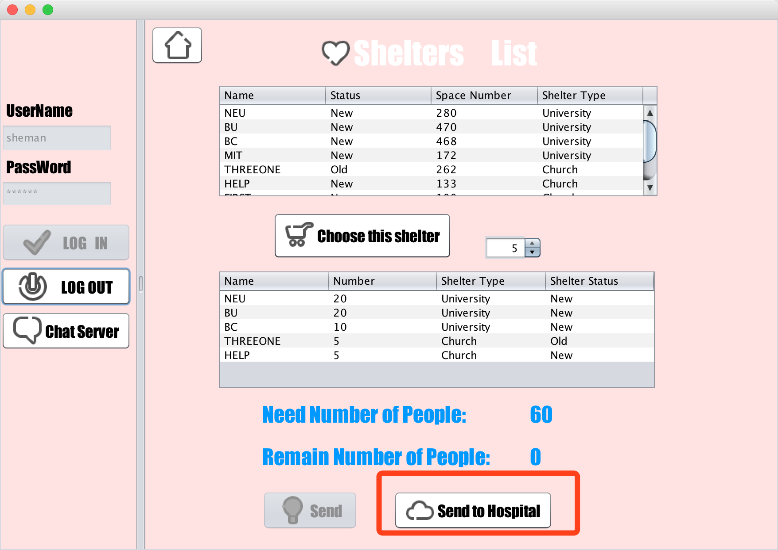
Screen Shots

Slide 32
Screen Shots
Make Appointment with Hospital

Slide 33
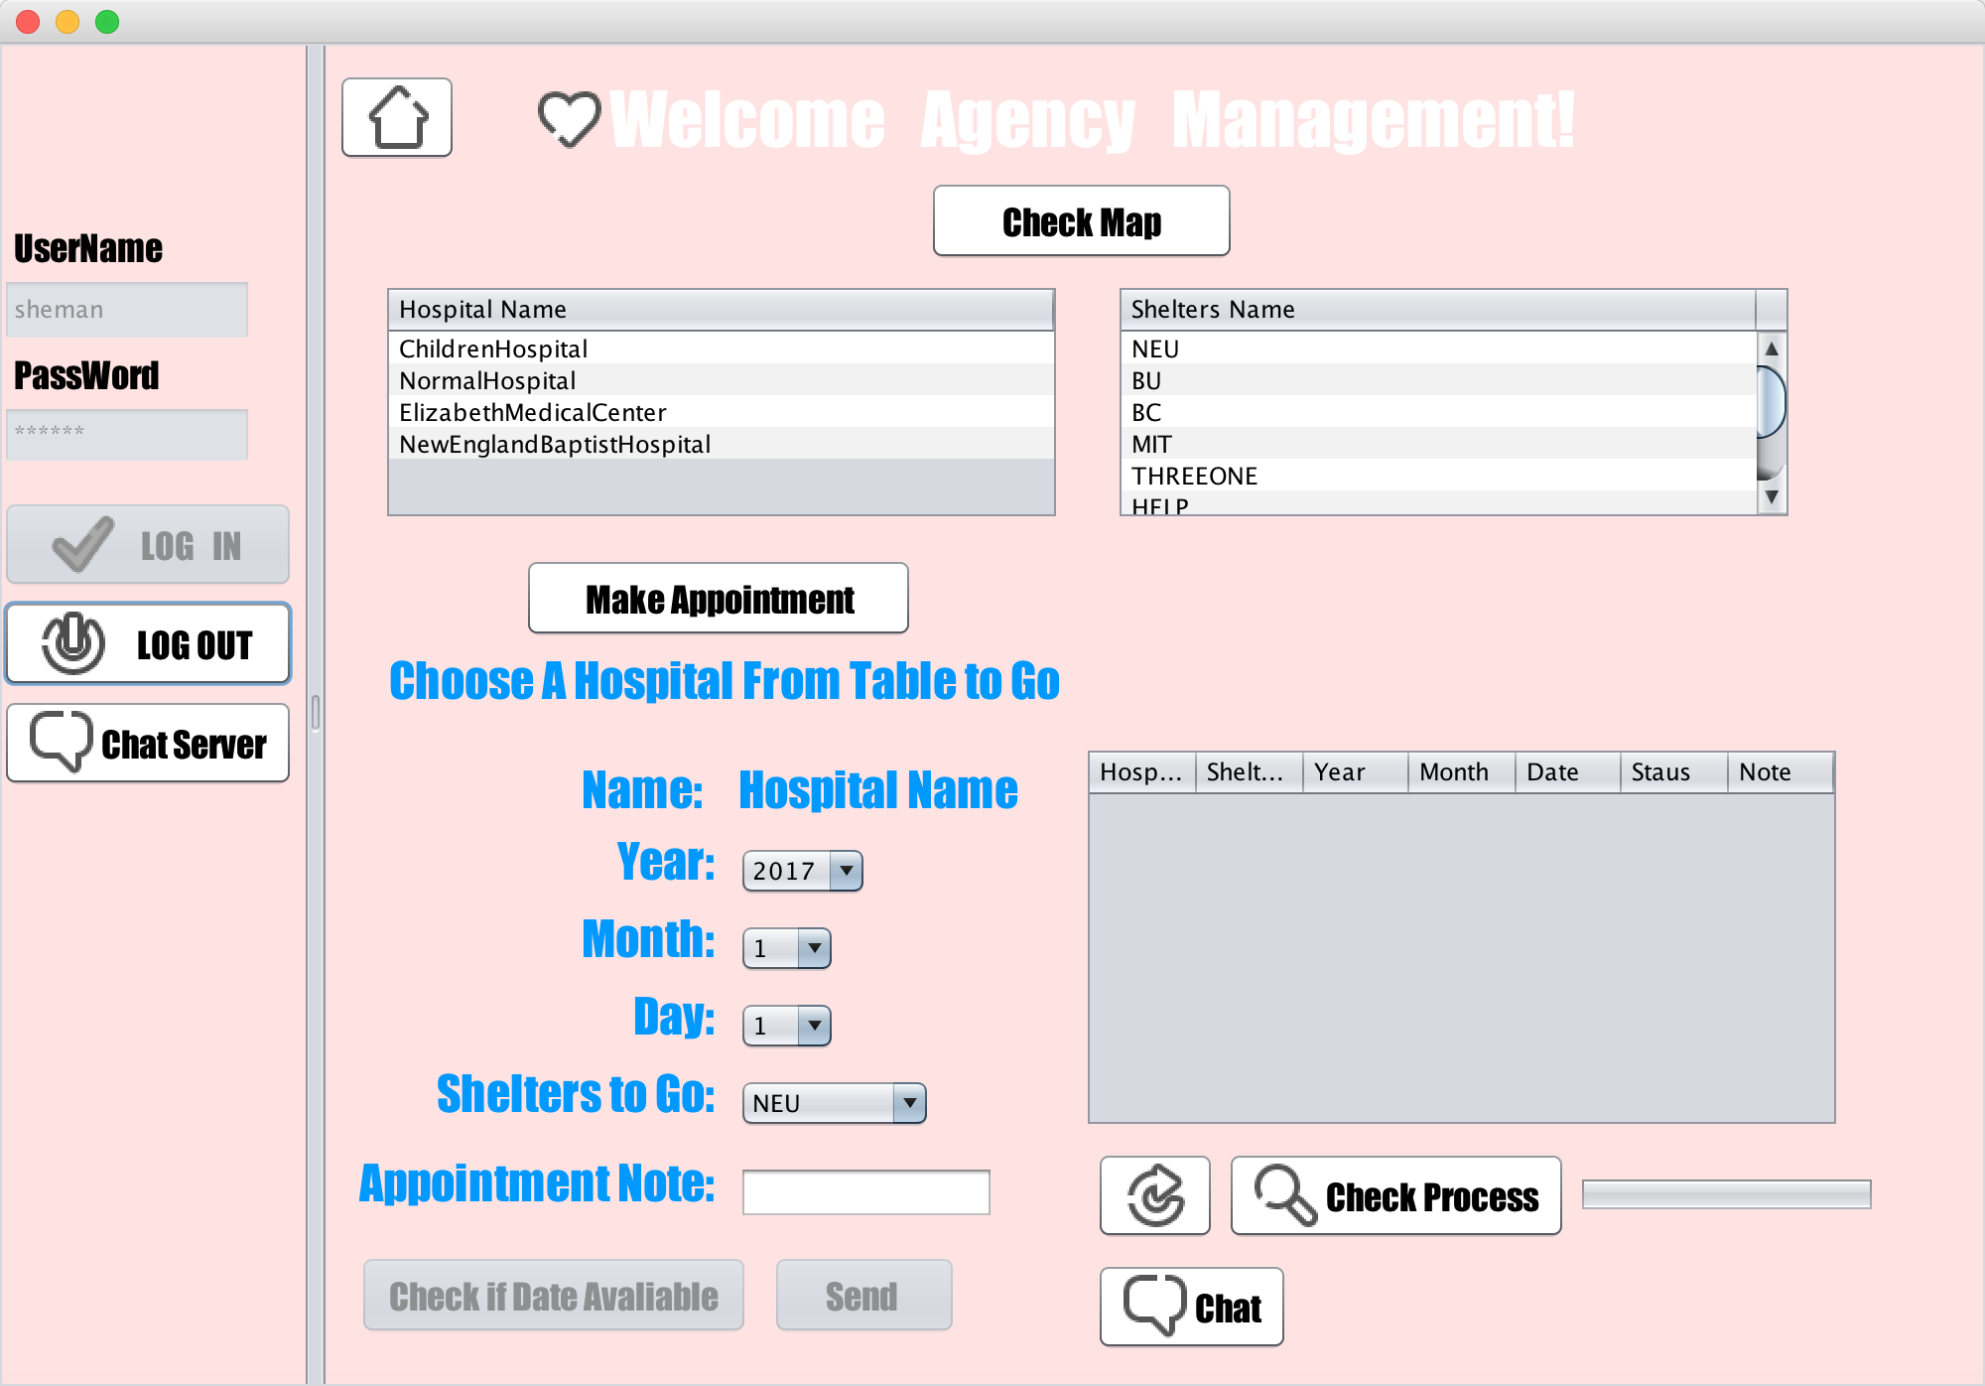
Screen Shots

Slide 34
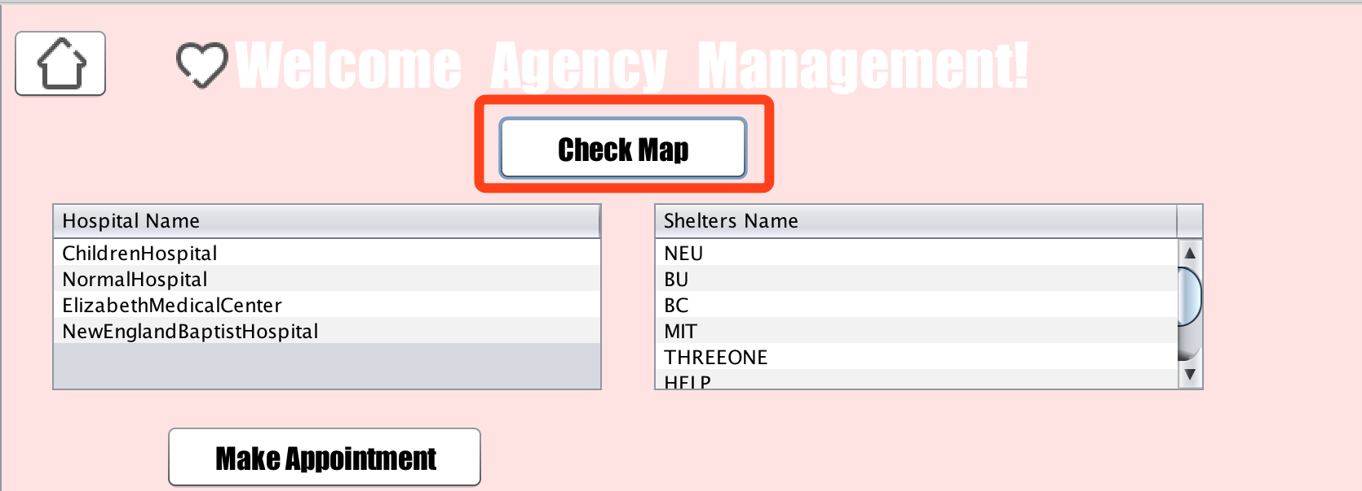
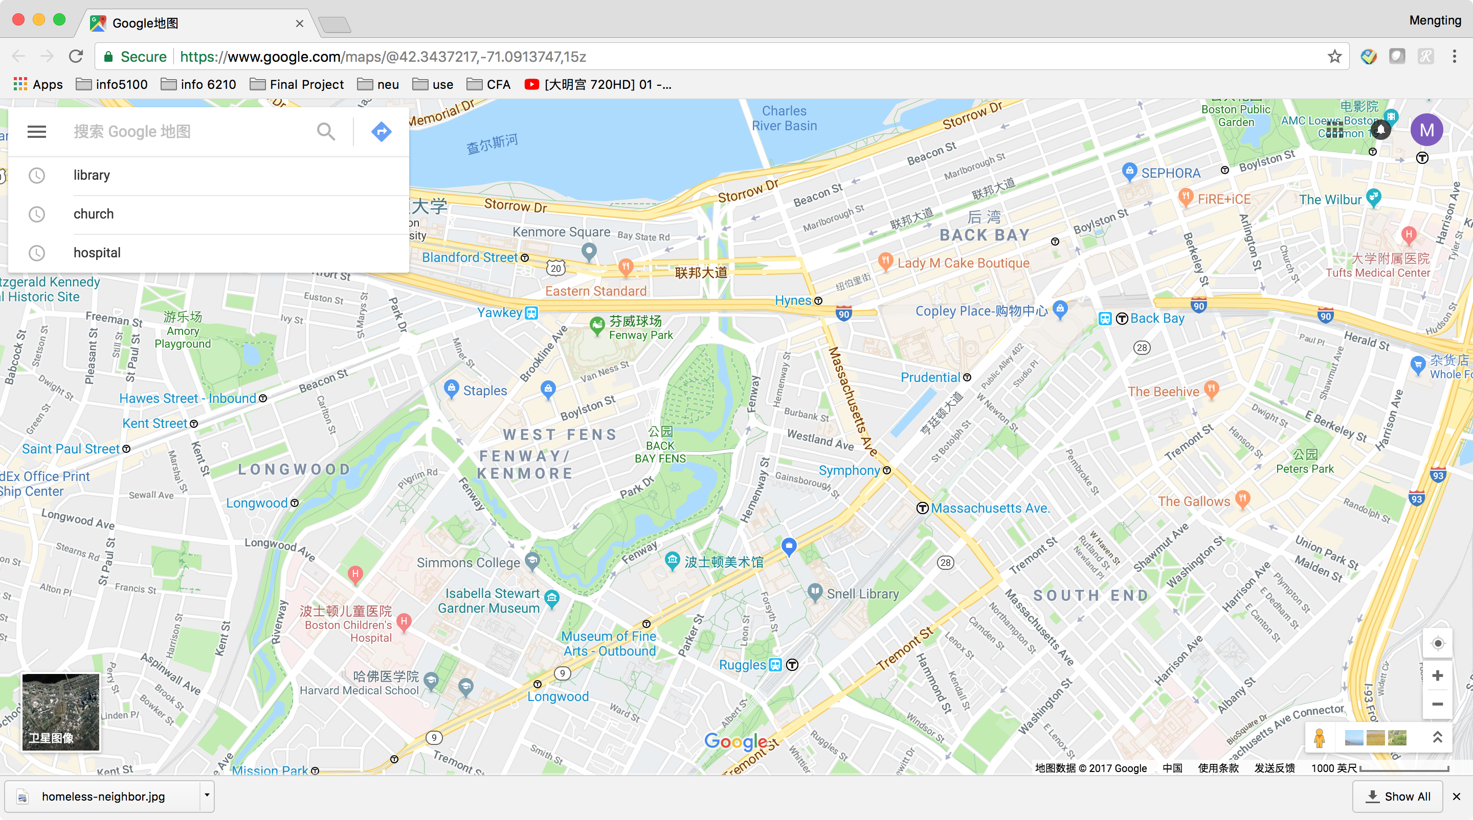
Screen Shots

Slide 35
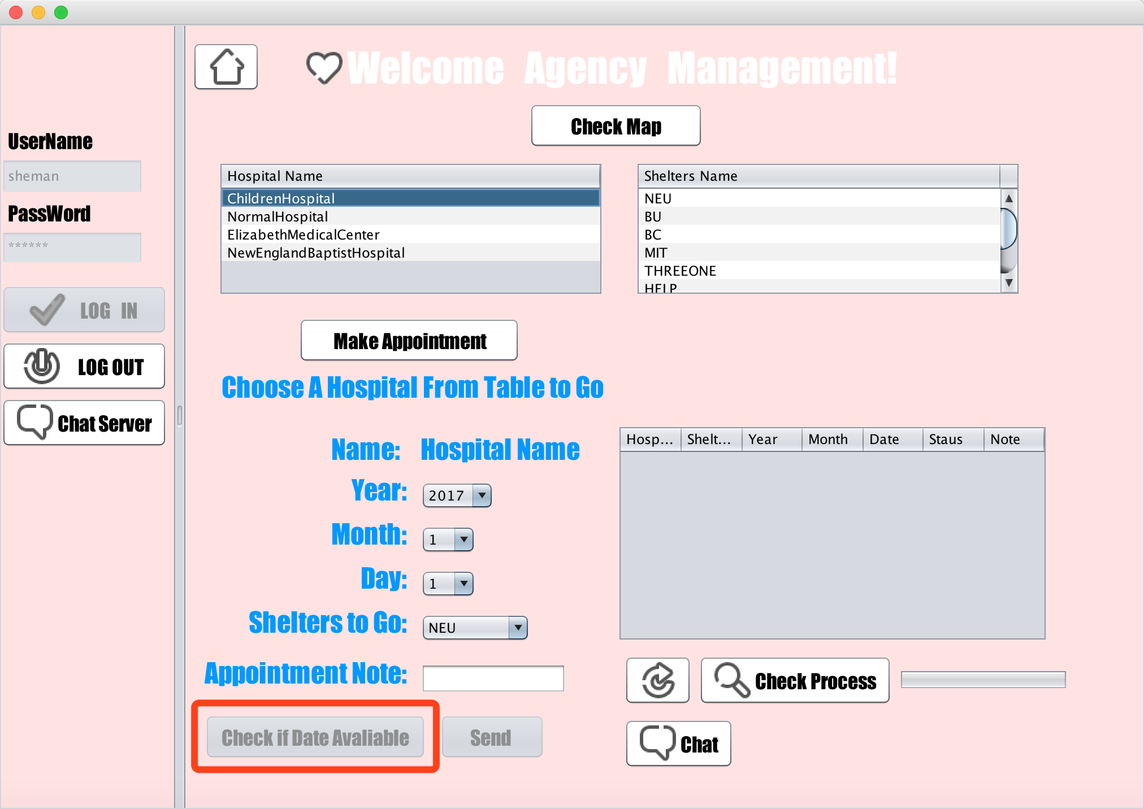
Screen Shots

Slide 36
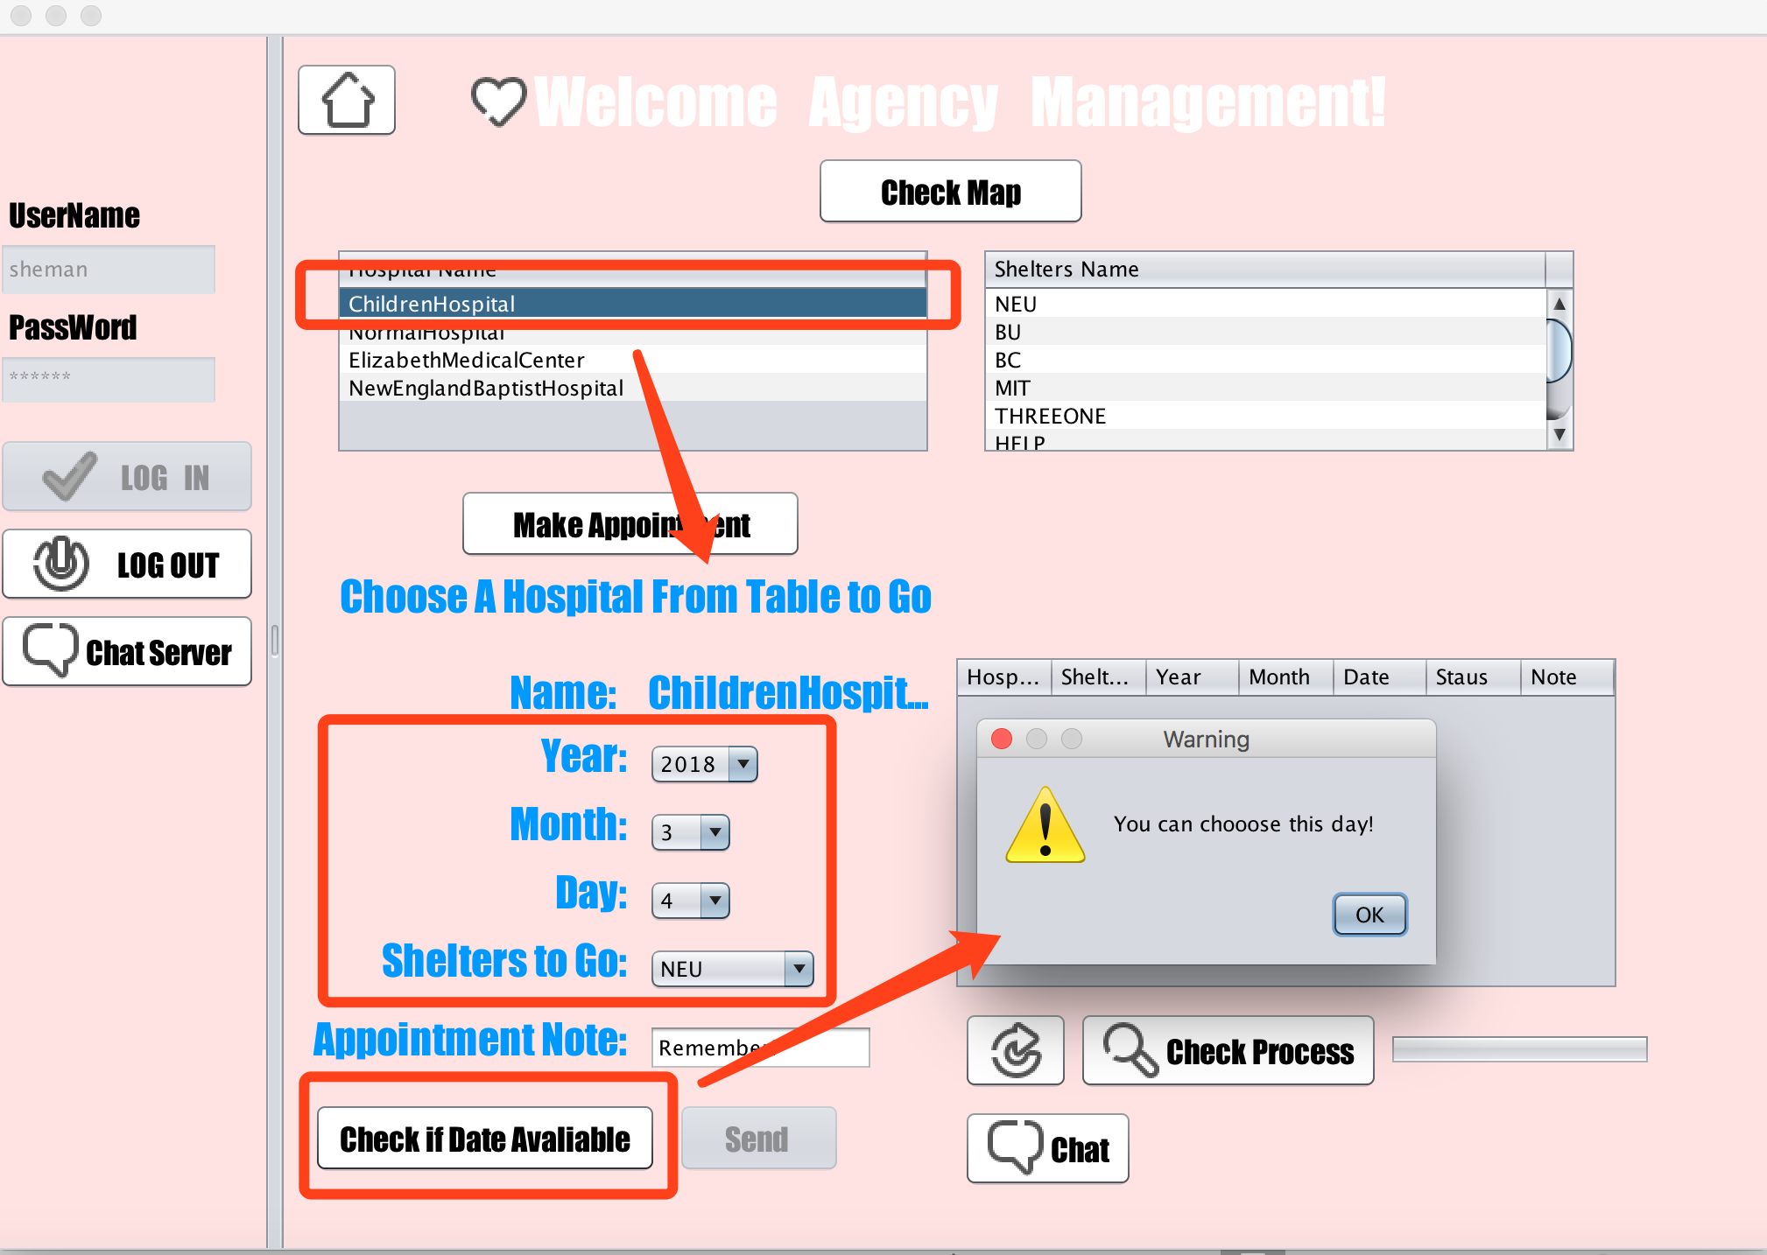
Screen Shots

Slide 37
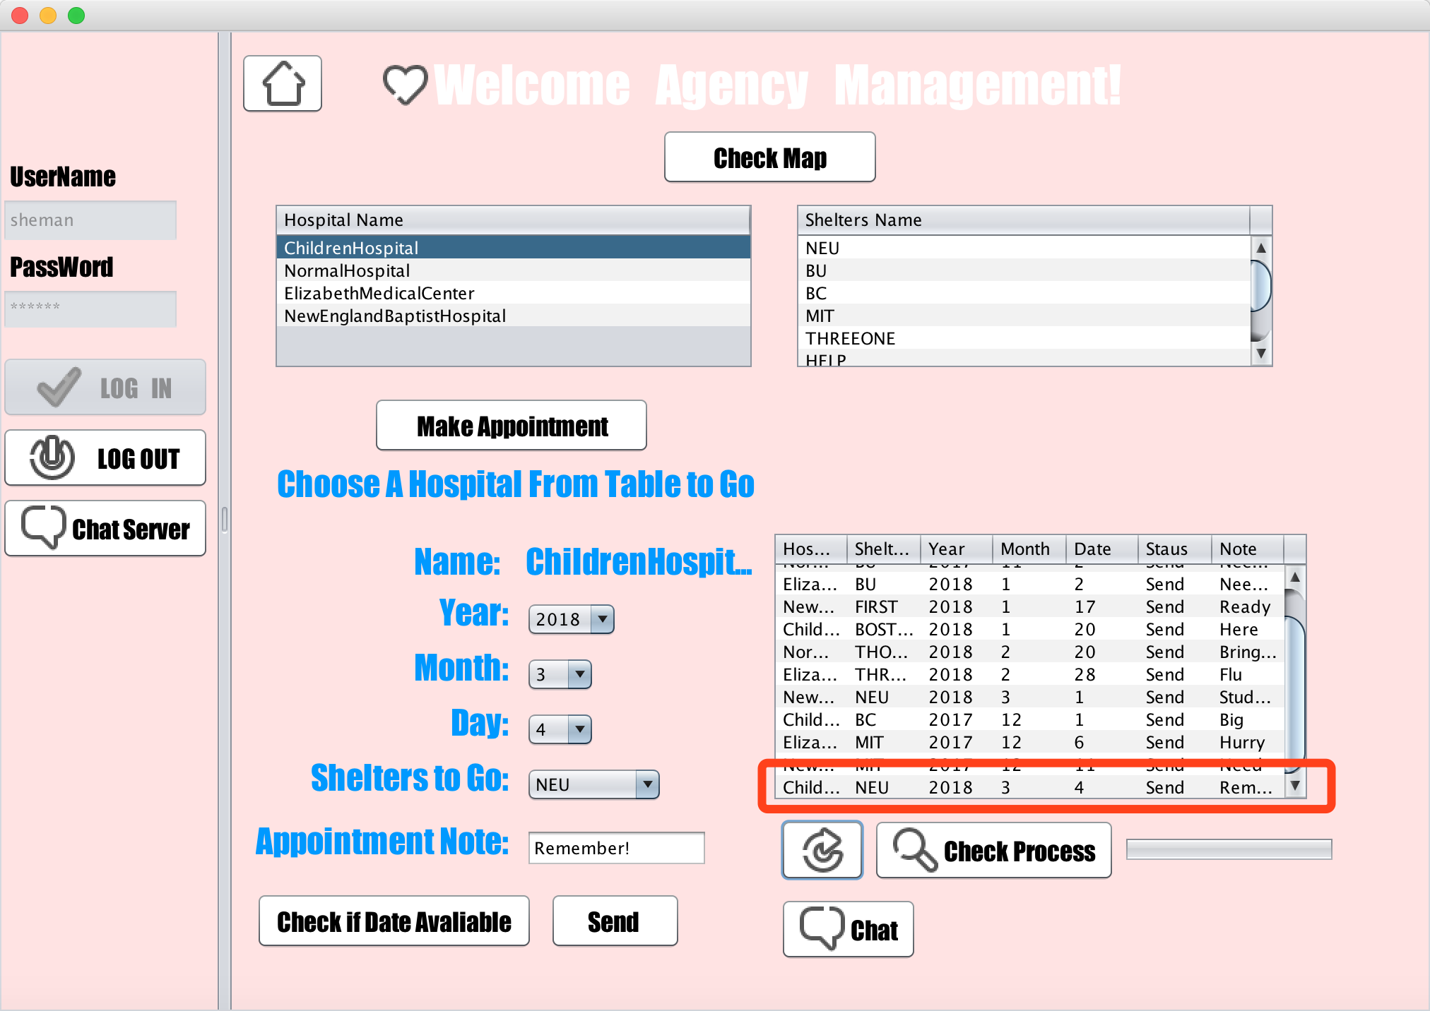
Screen Shots

Slide 38
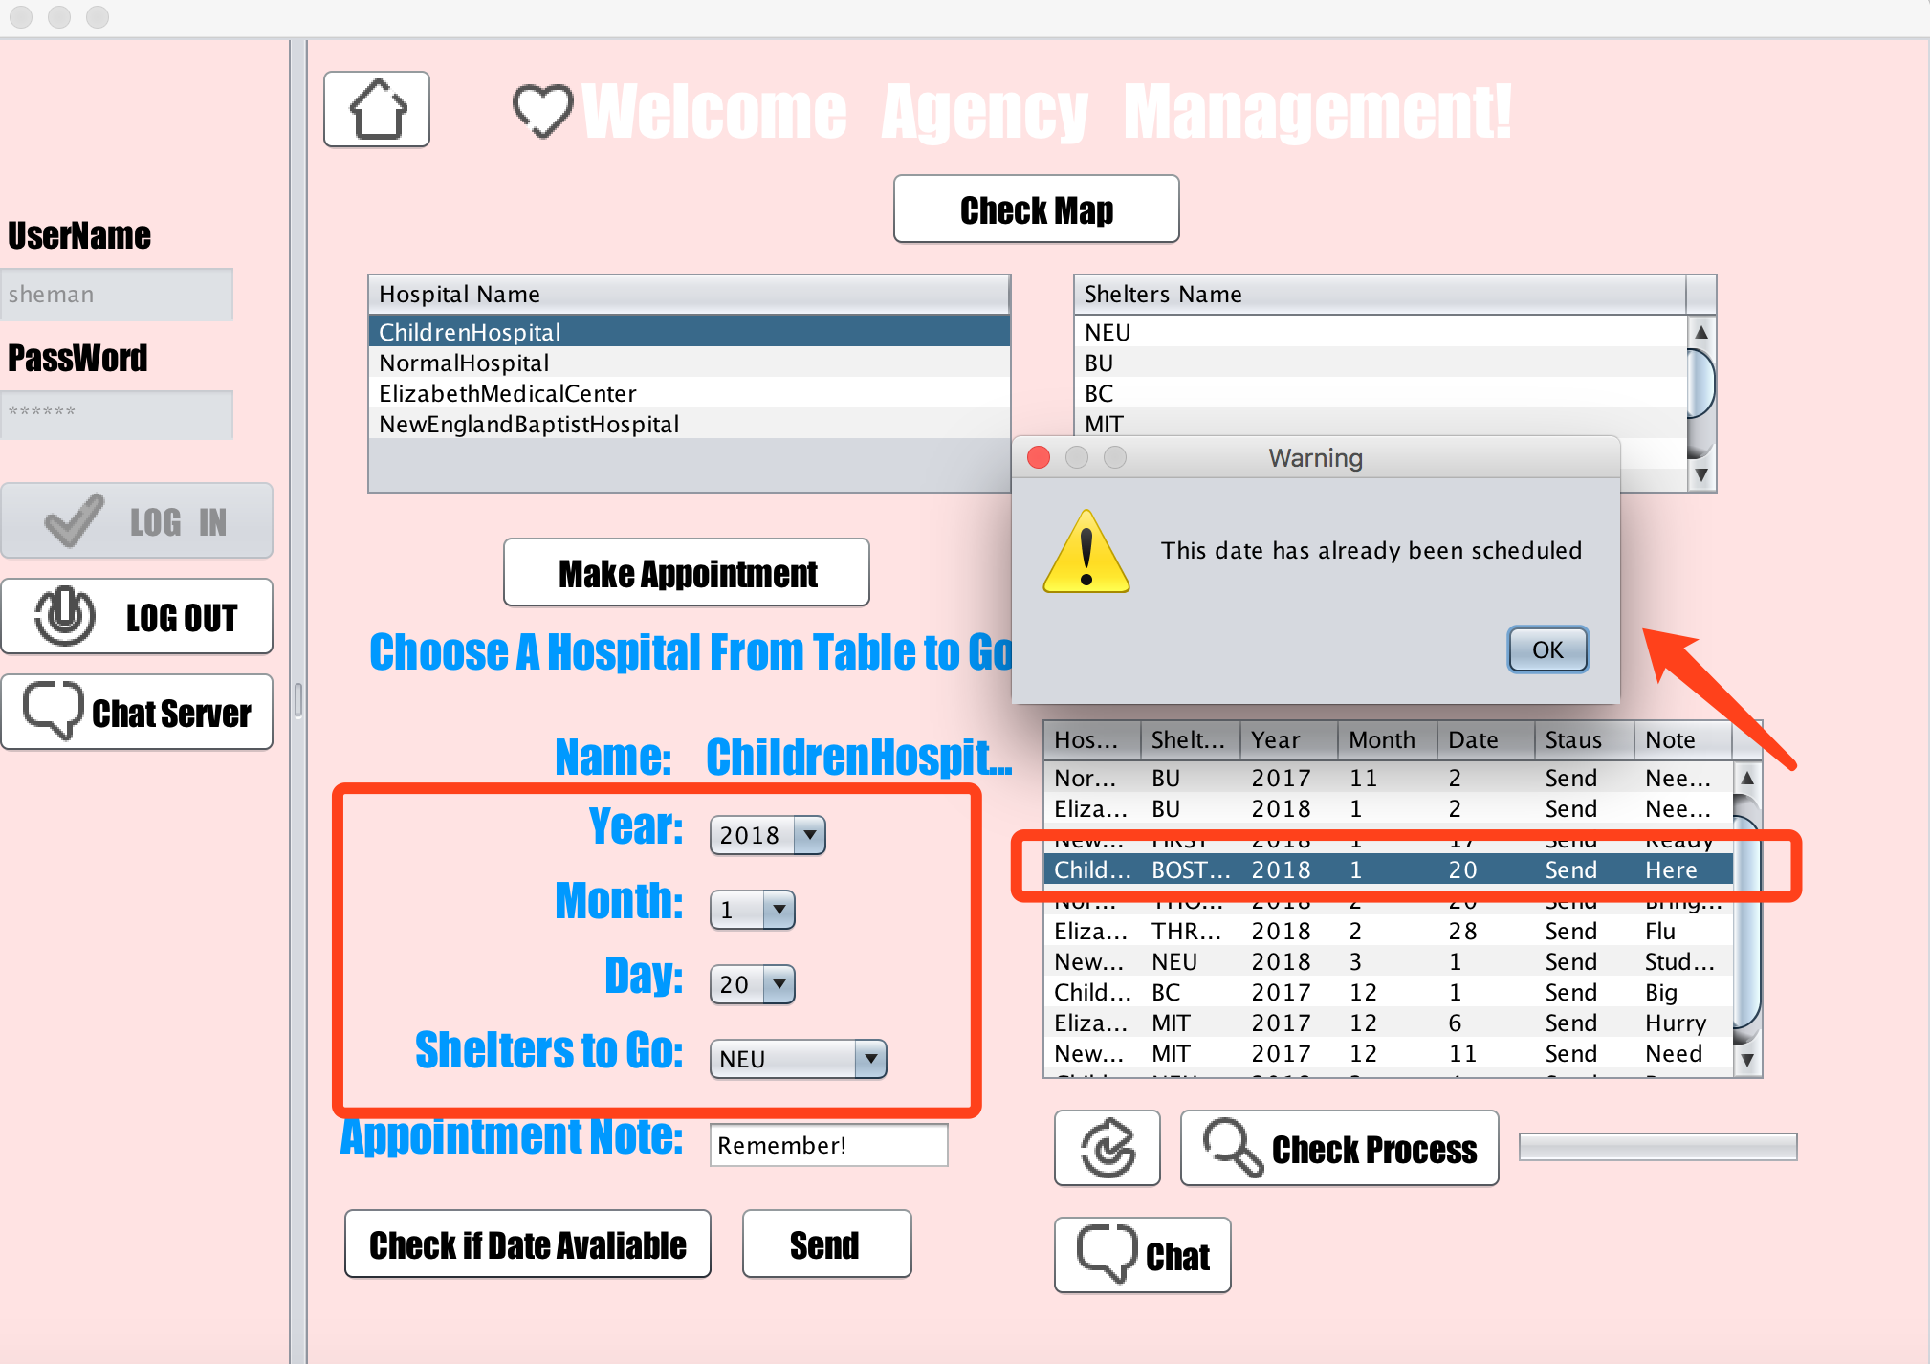
Screen Shots

Slide 39
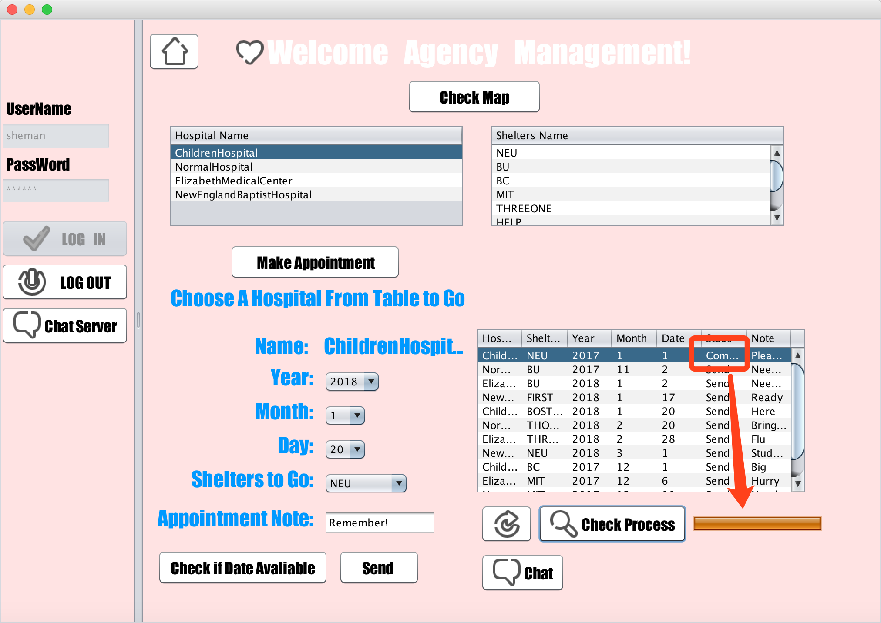
Screen Shots

Slide 40
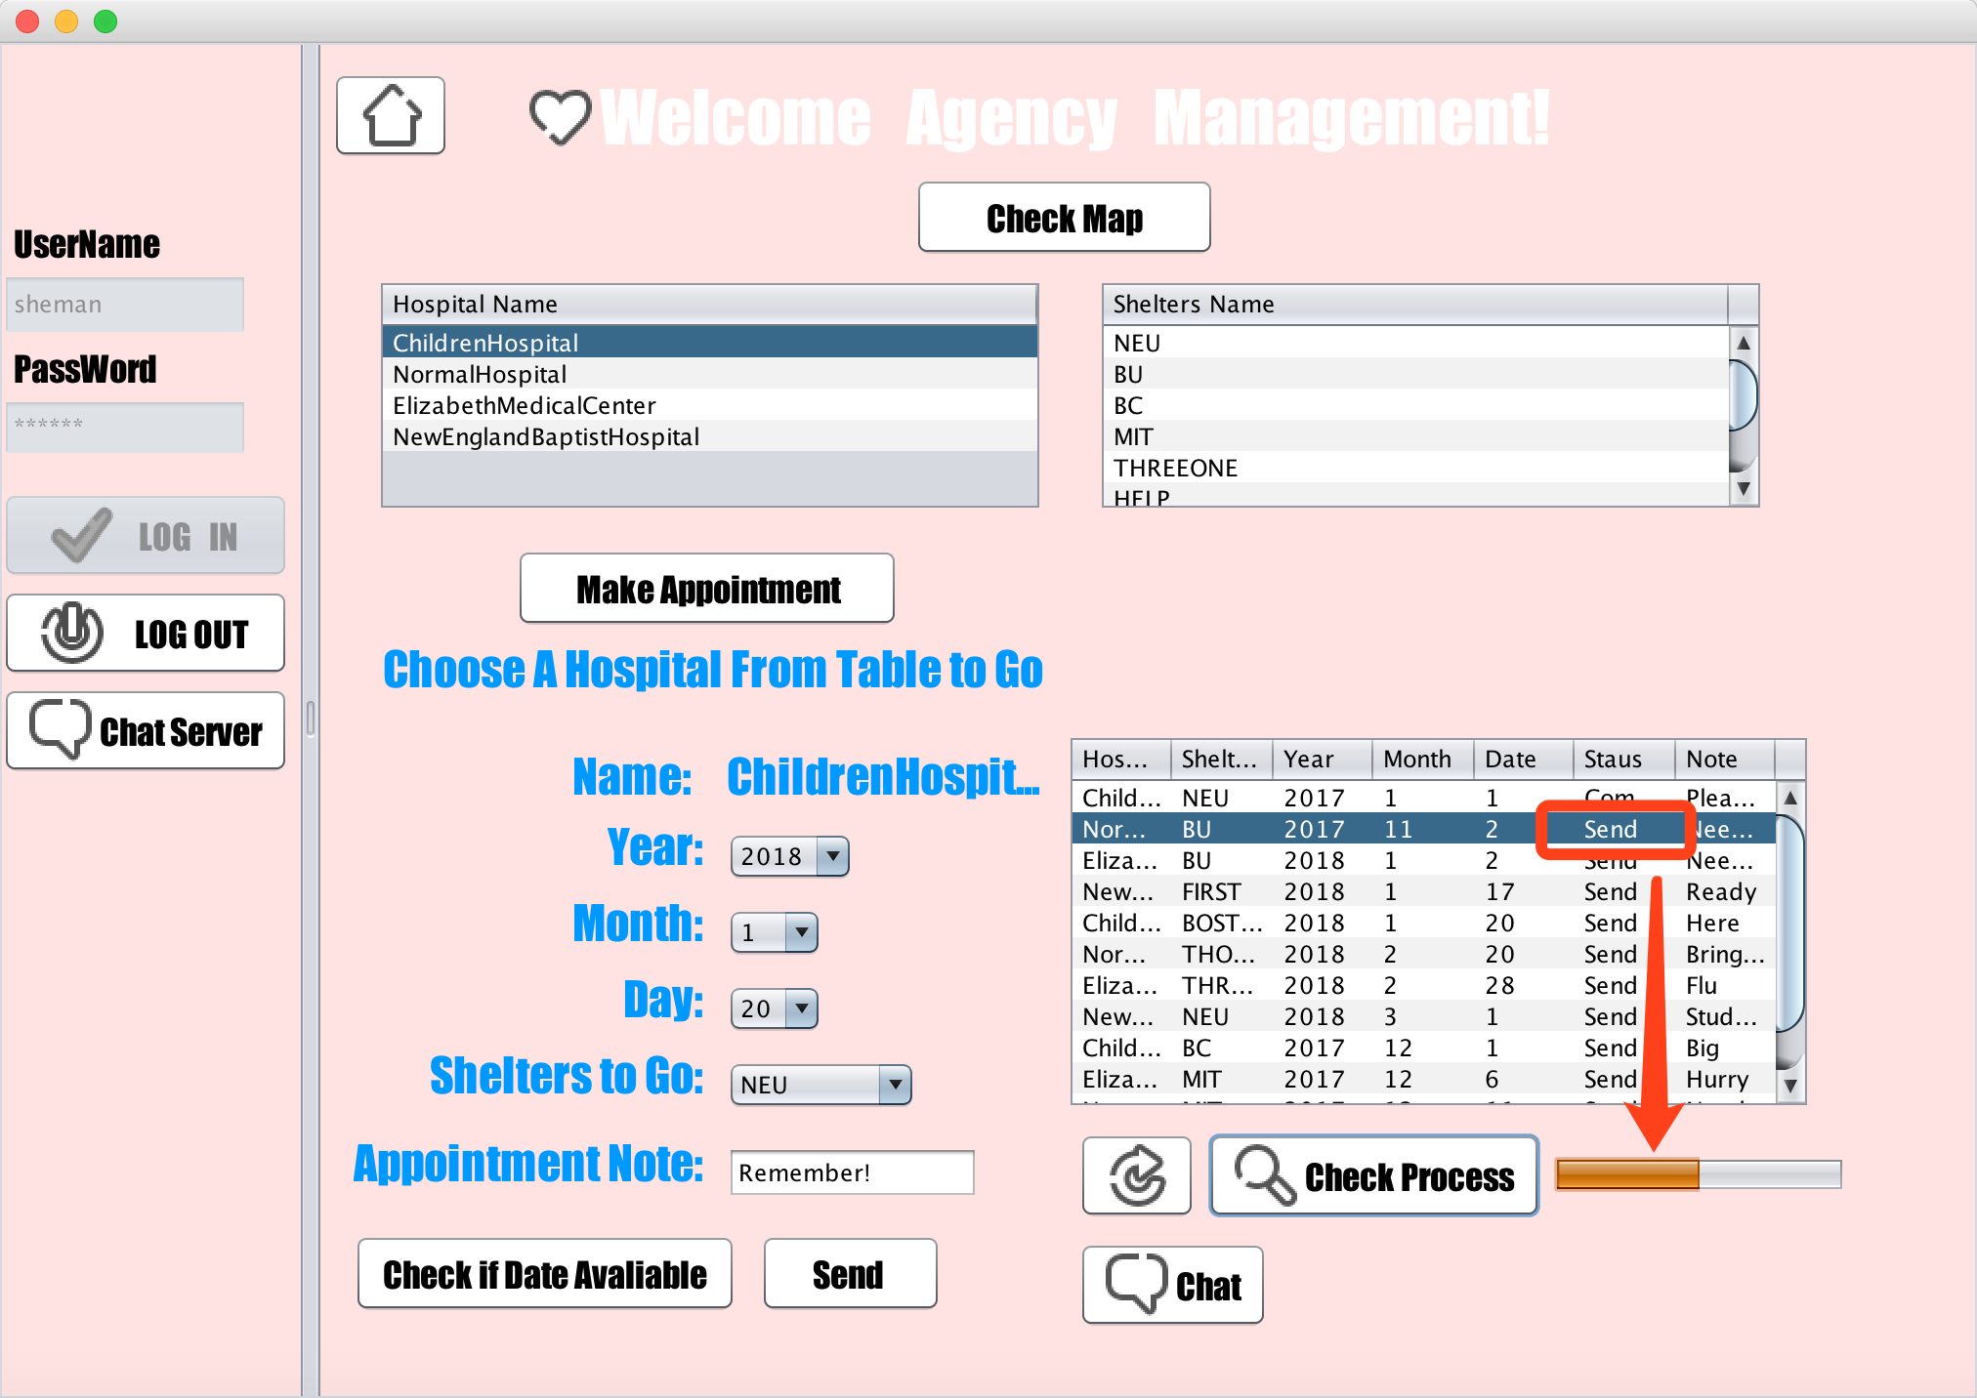
Screen Shots

Slide 41
Screen Shots
Government Admin Role

Slide 42
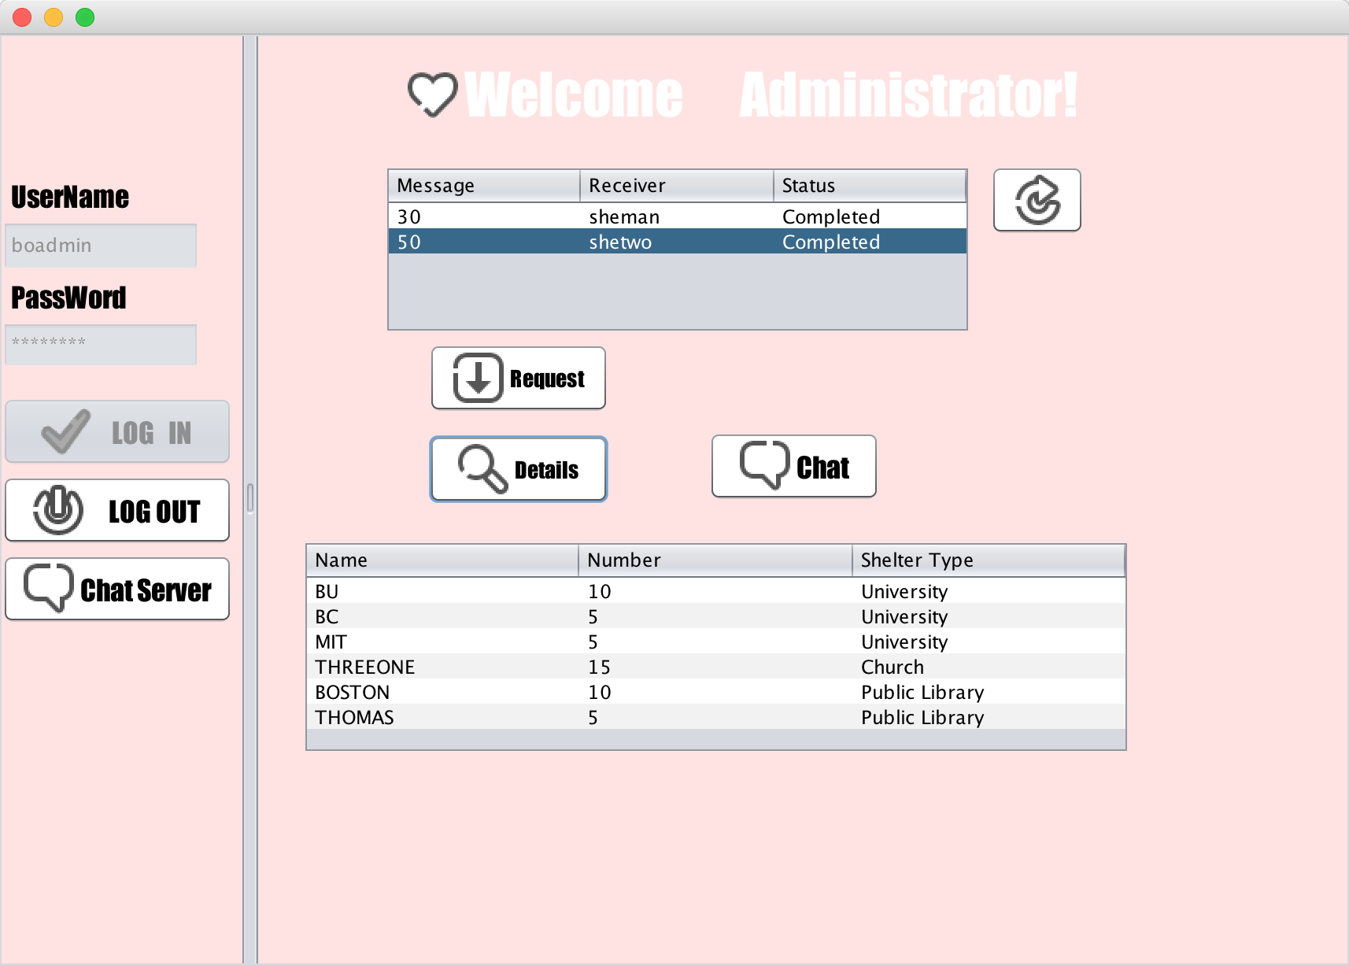
Screen Shots

Slide 43
Screen Shots
Physical Examination Role

Slide 44
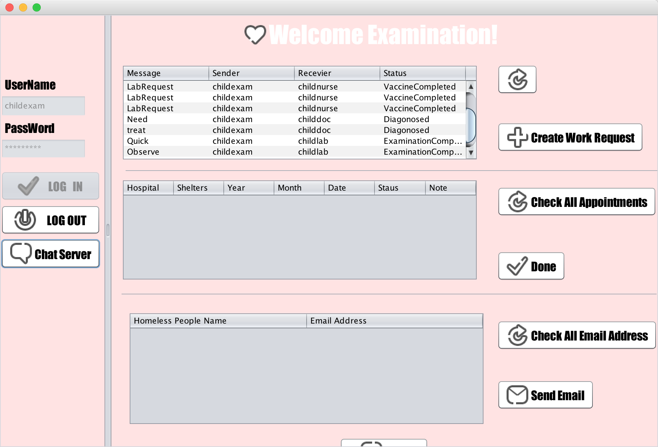
Screen Shots

Slide 45
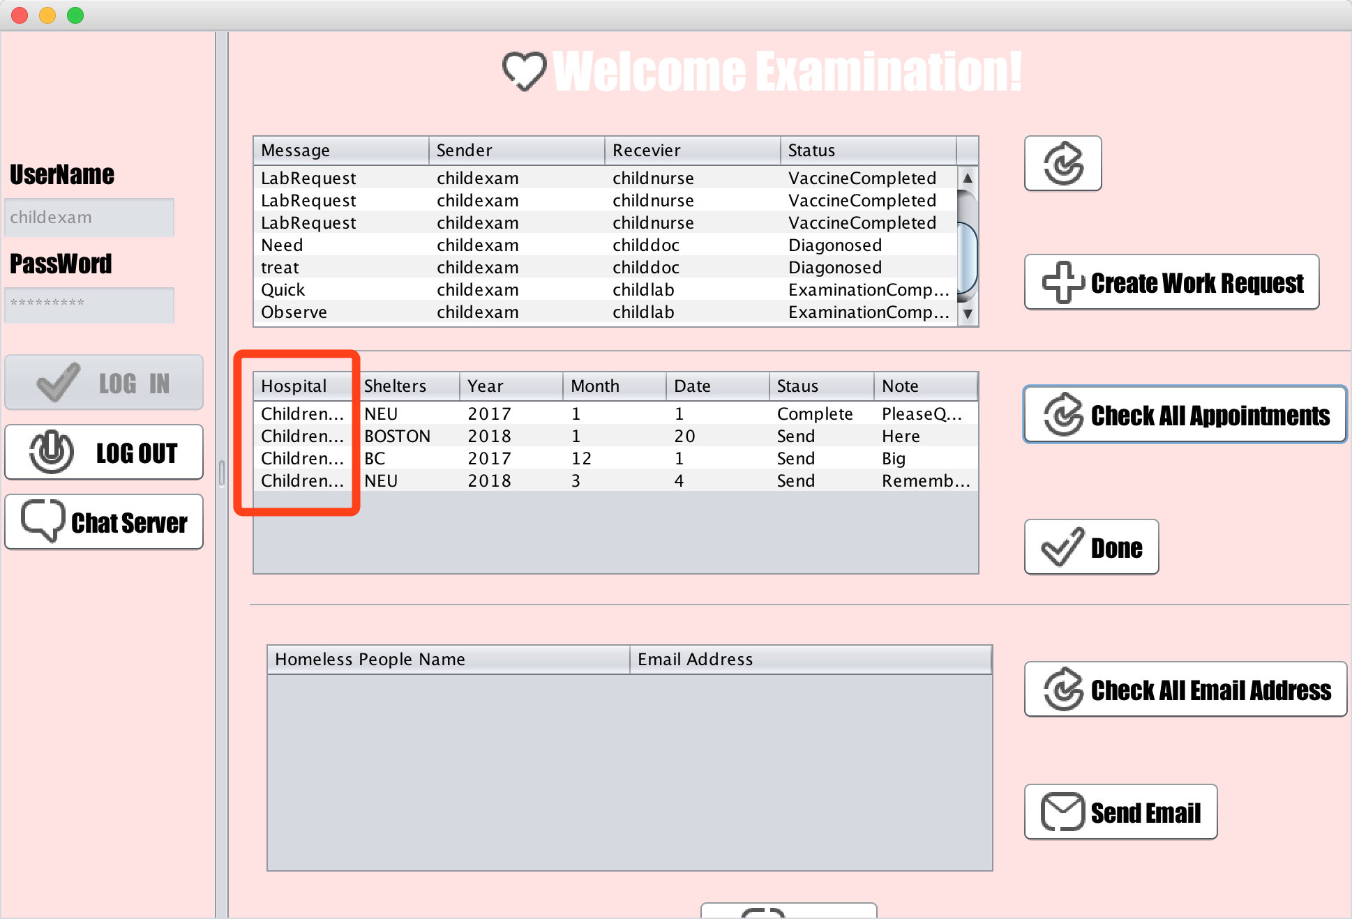
Screen Shots

Slide 46
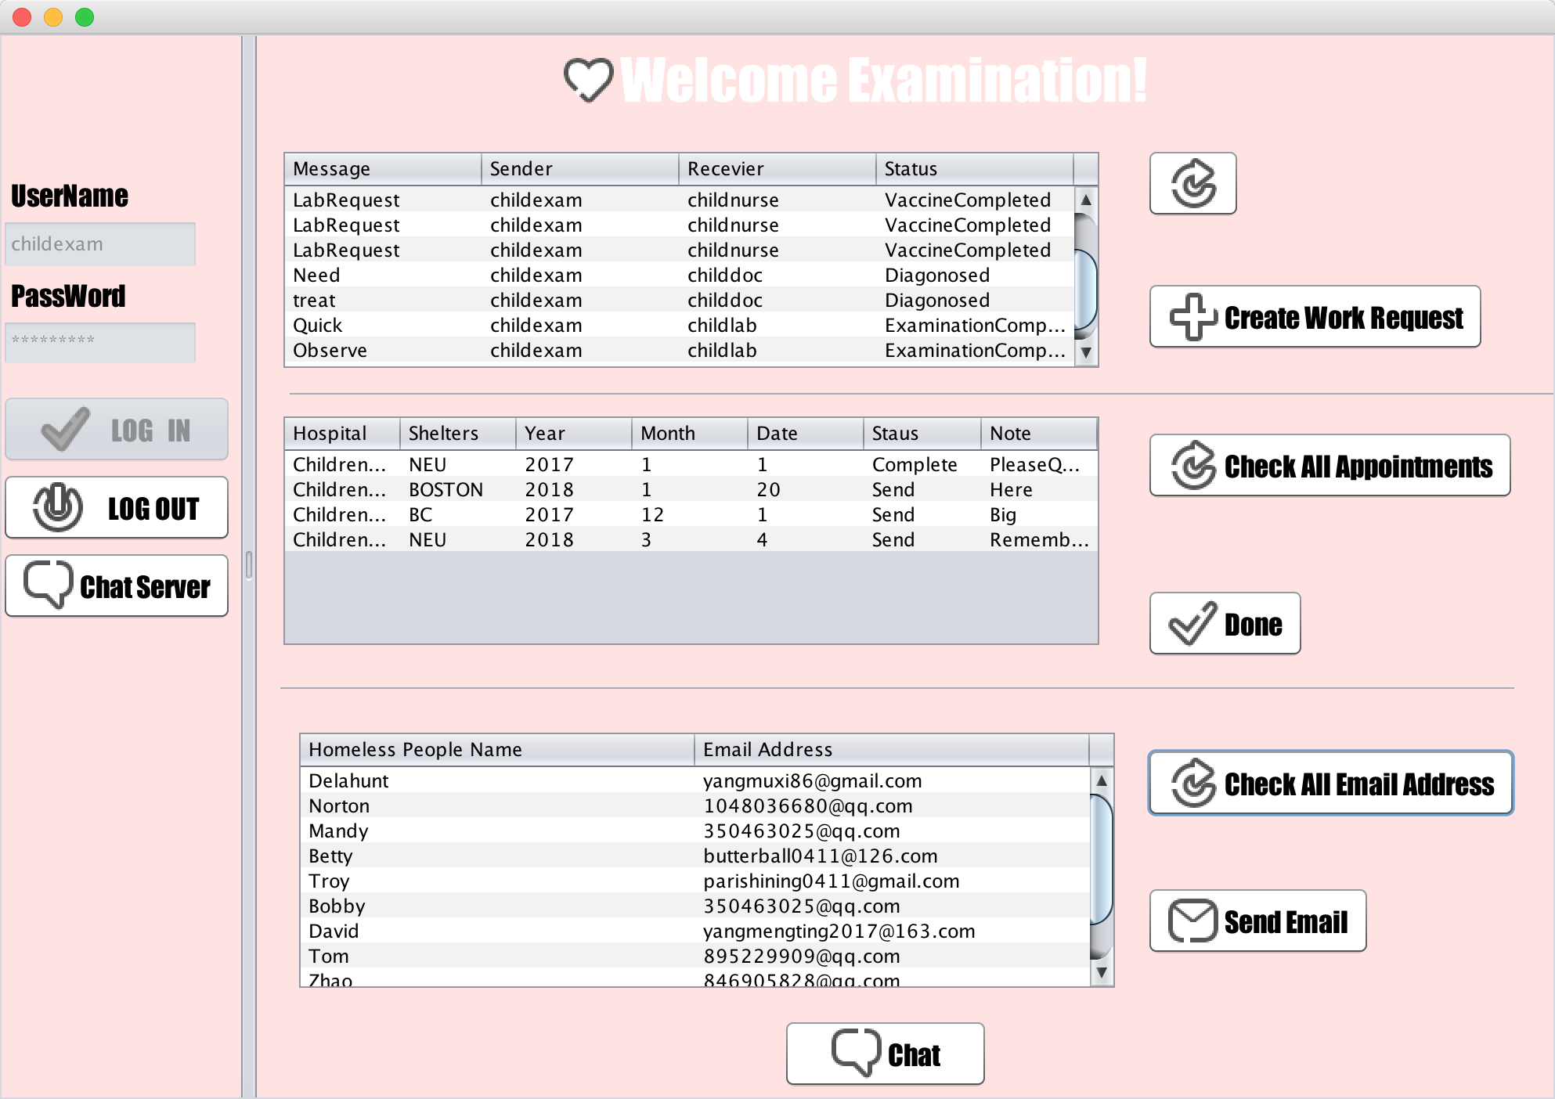
Screen Shots

Slide 47
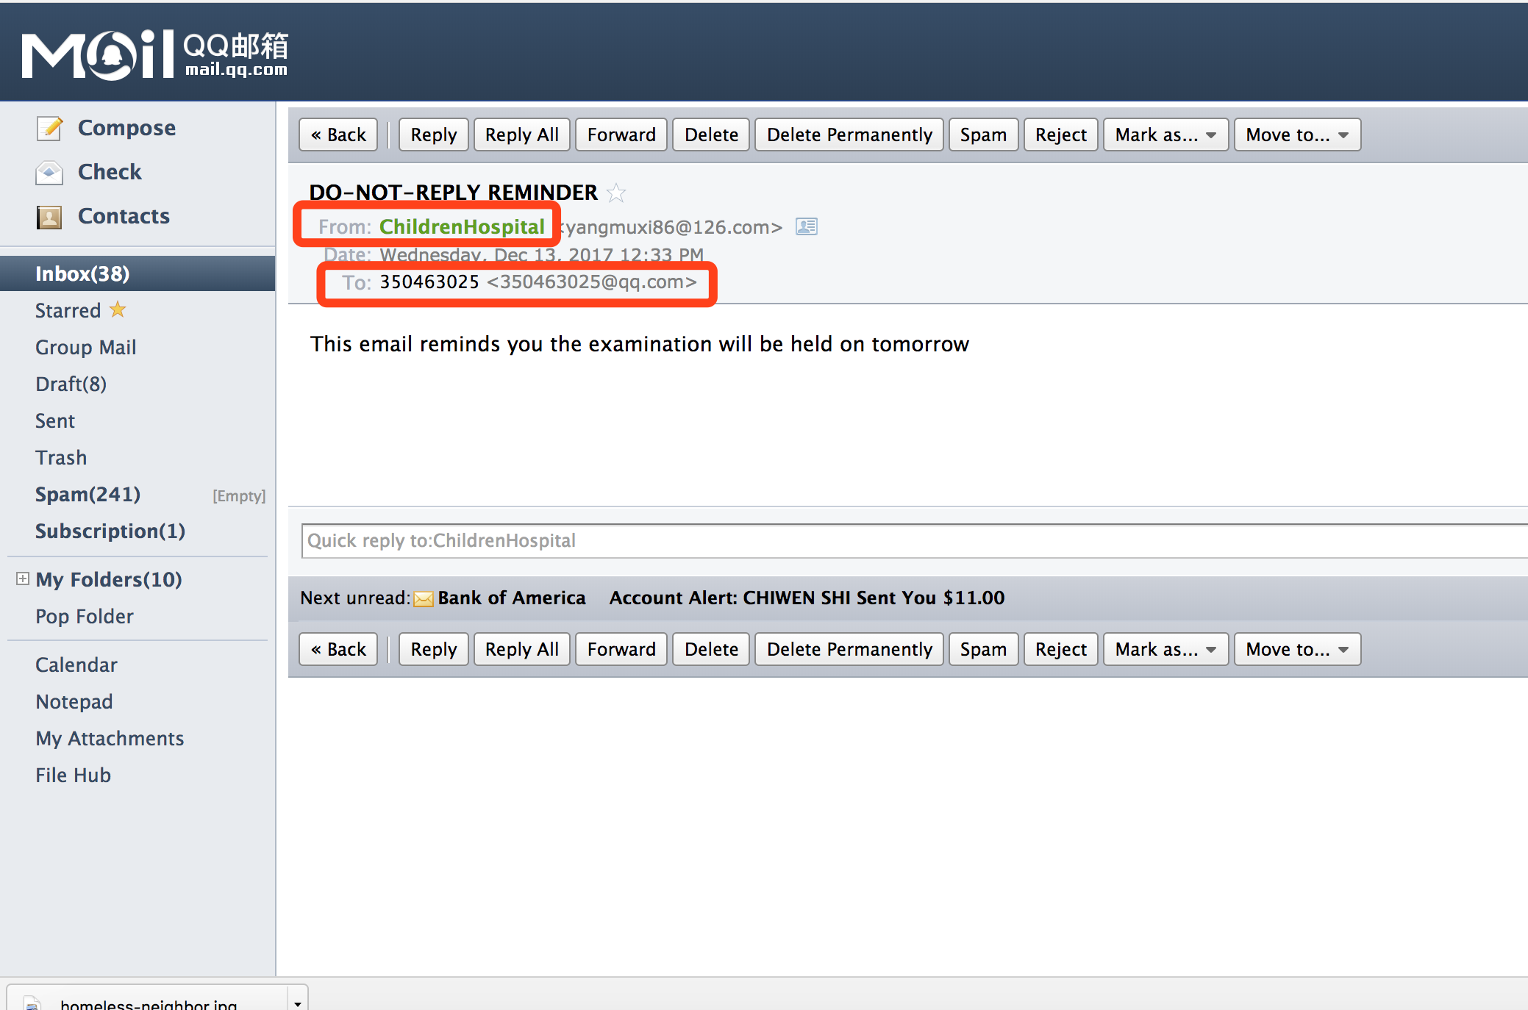
Screen Shots

Slide 48
Screen Shots
Lab Assistant Role

Slide 49
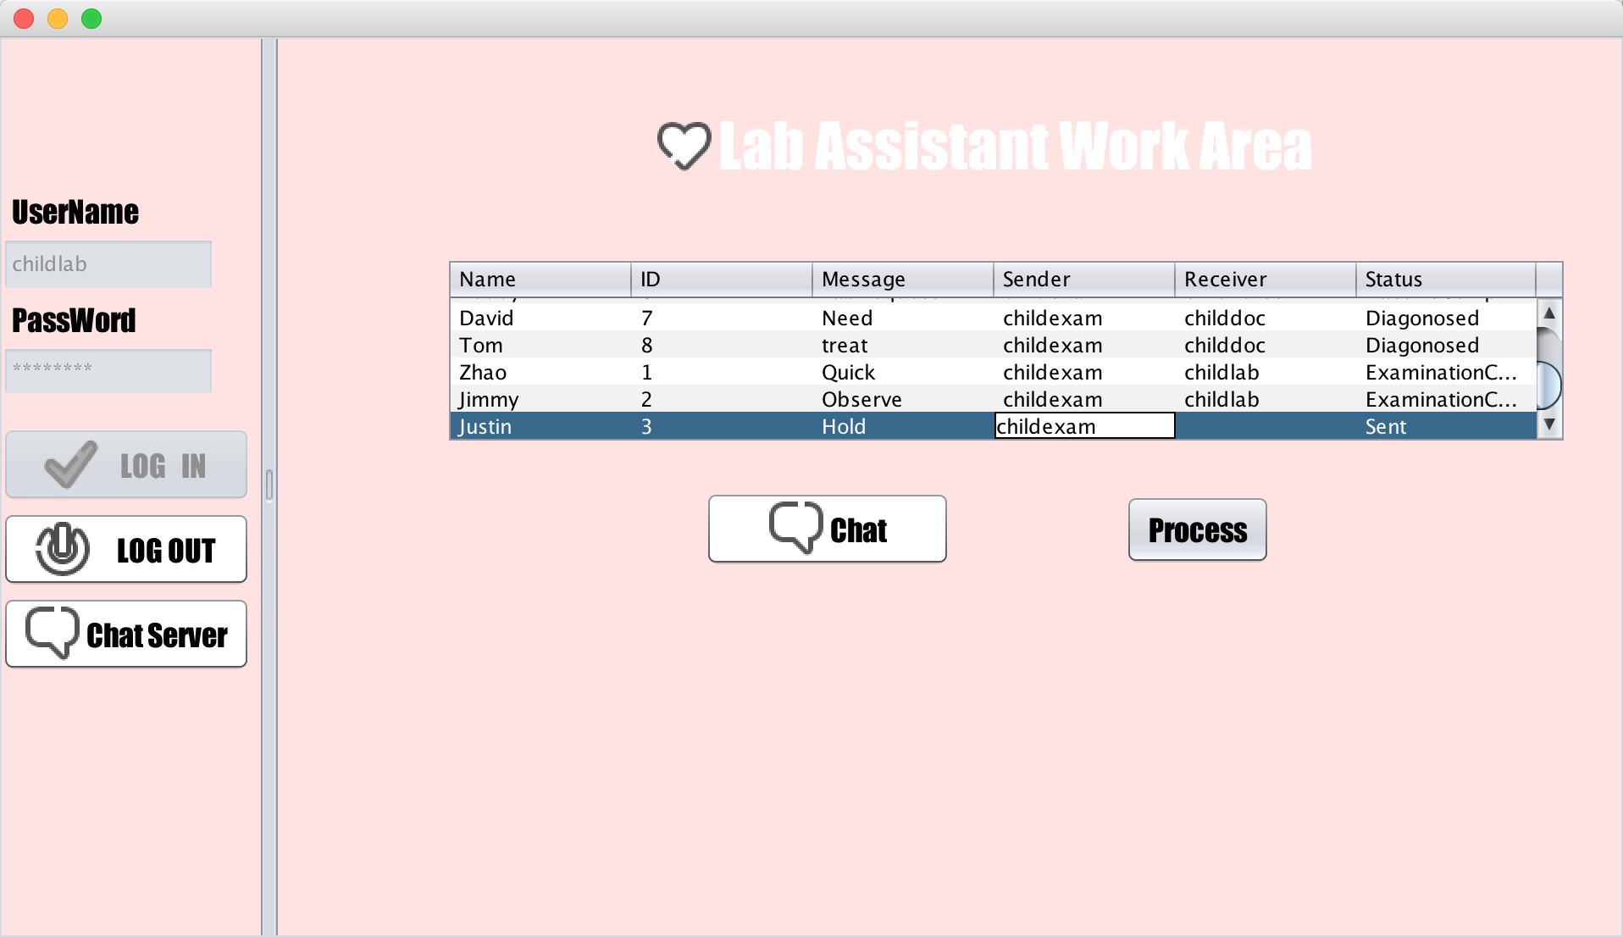
Screen Shots

Slide 50
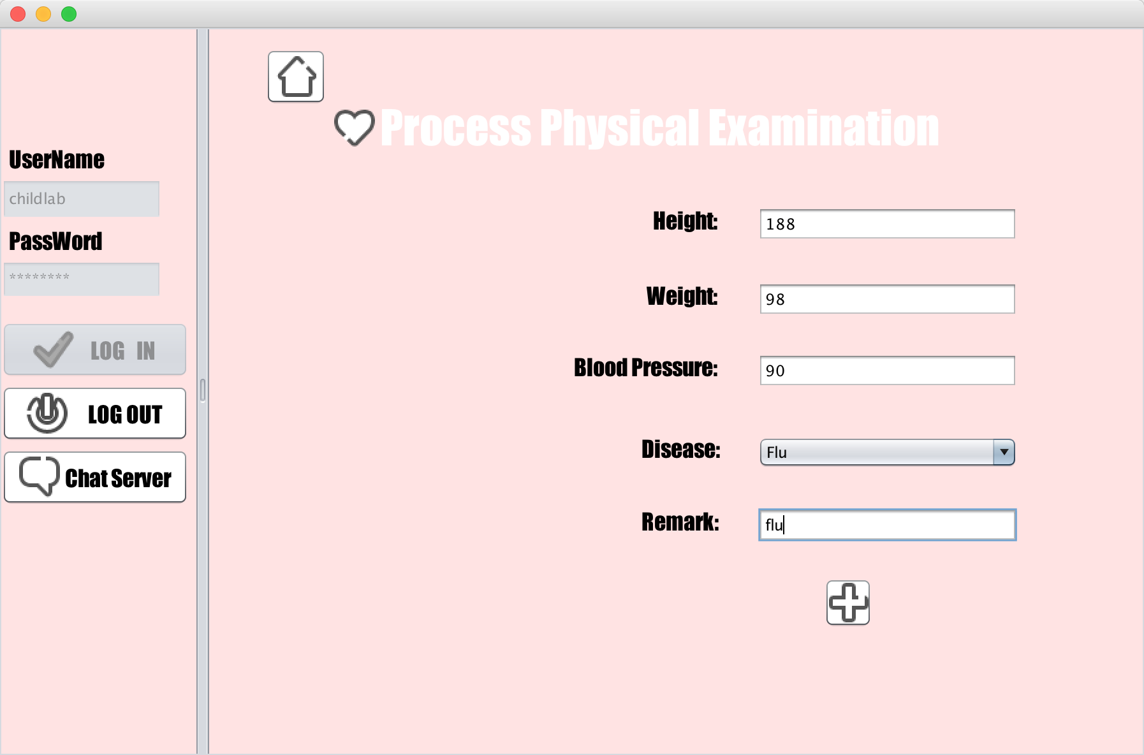
Screen Shots

Slide 51
Screen Shots
Doctor Role

Slide 52
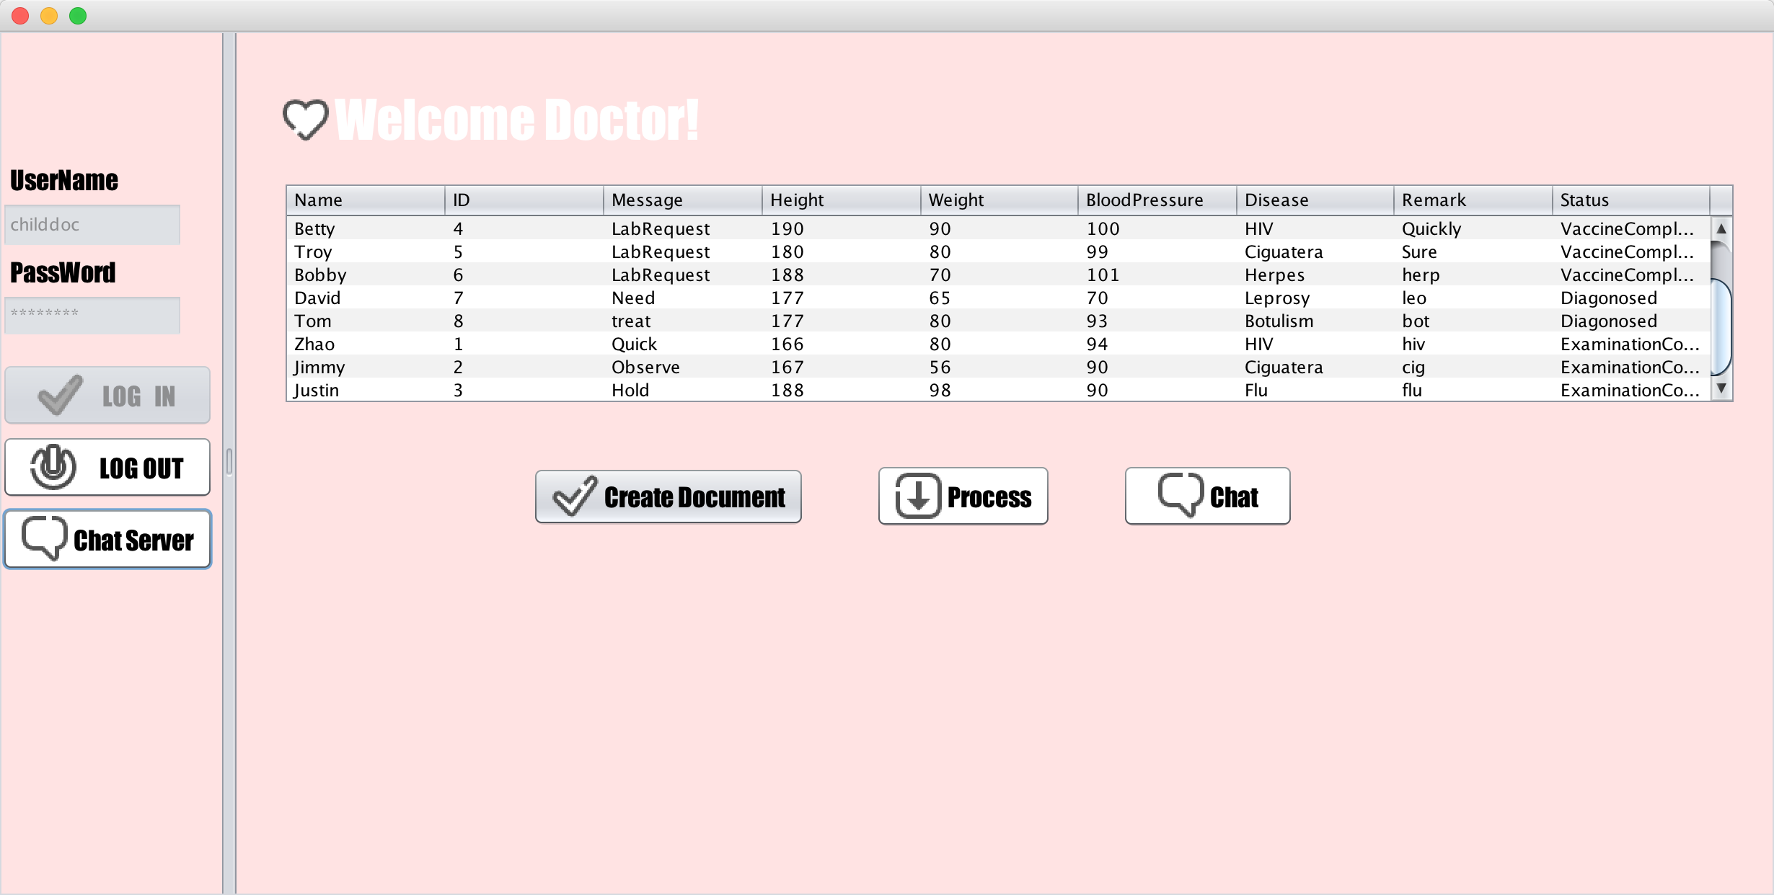
Screen Shots

Slide 53
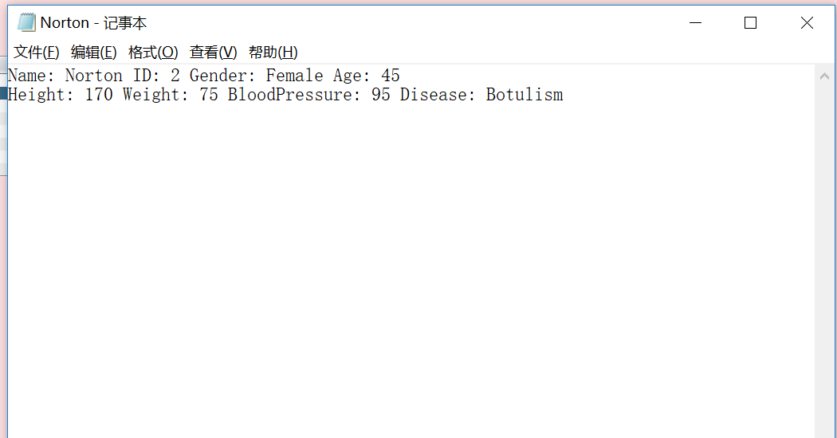
Screen Shots

Slide 54
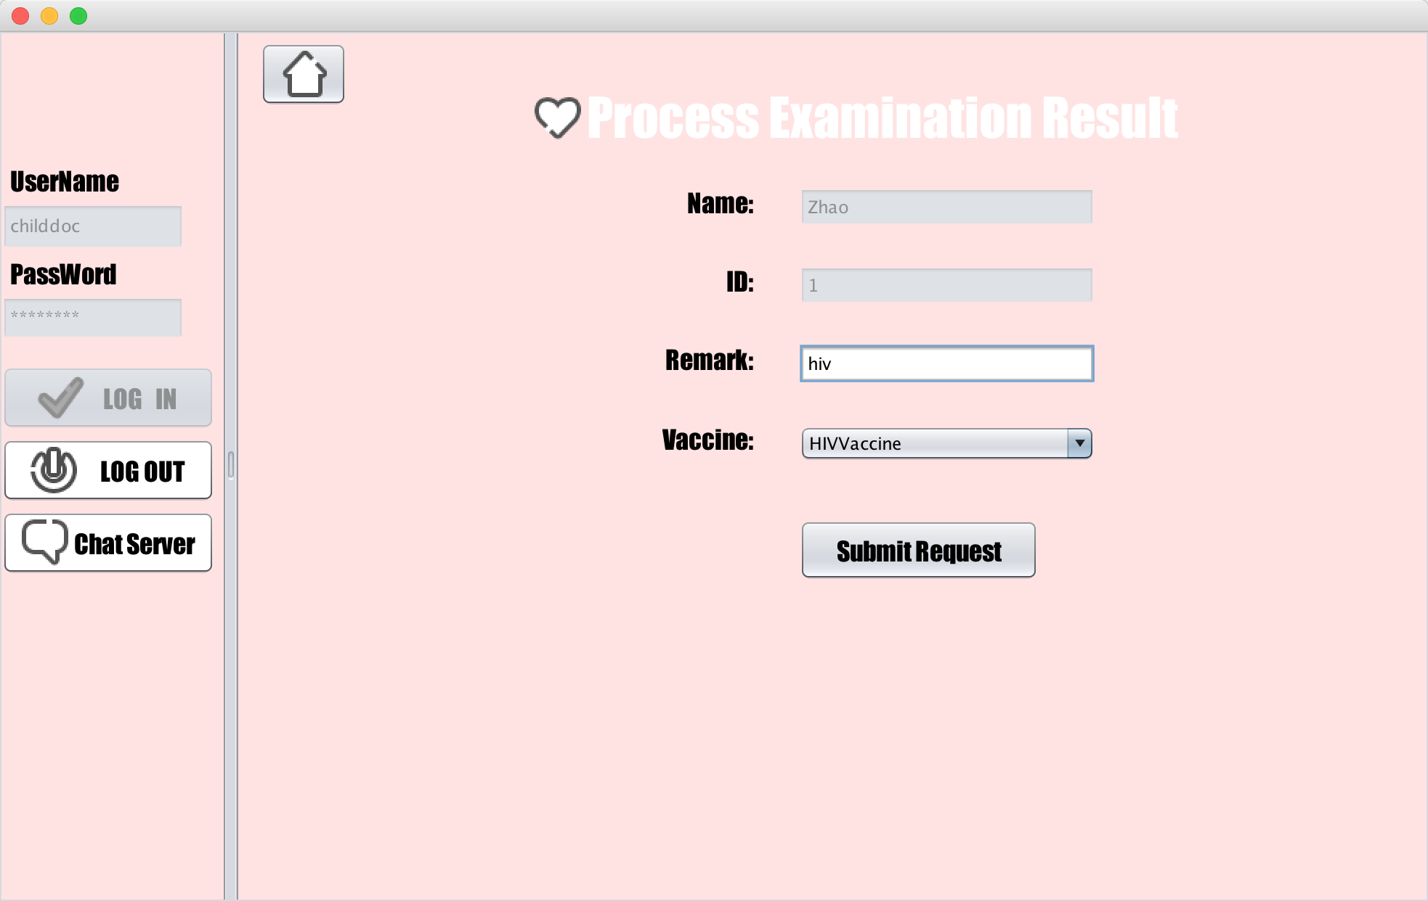
Screen Shots

Slide 55
Screen Shots
Nurse Role

Slide 56
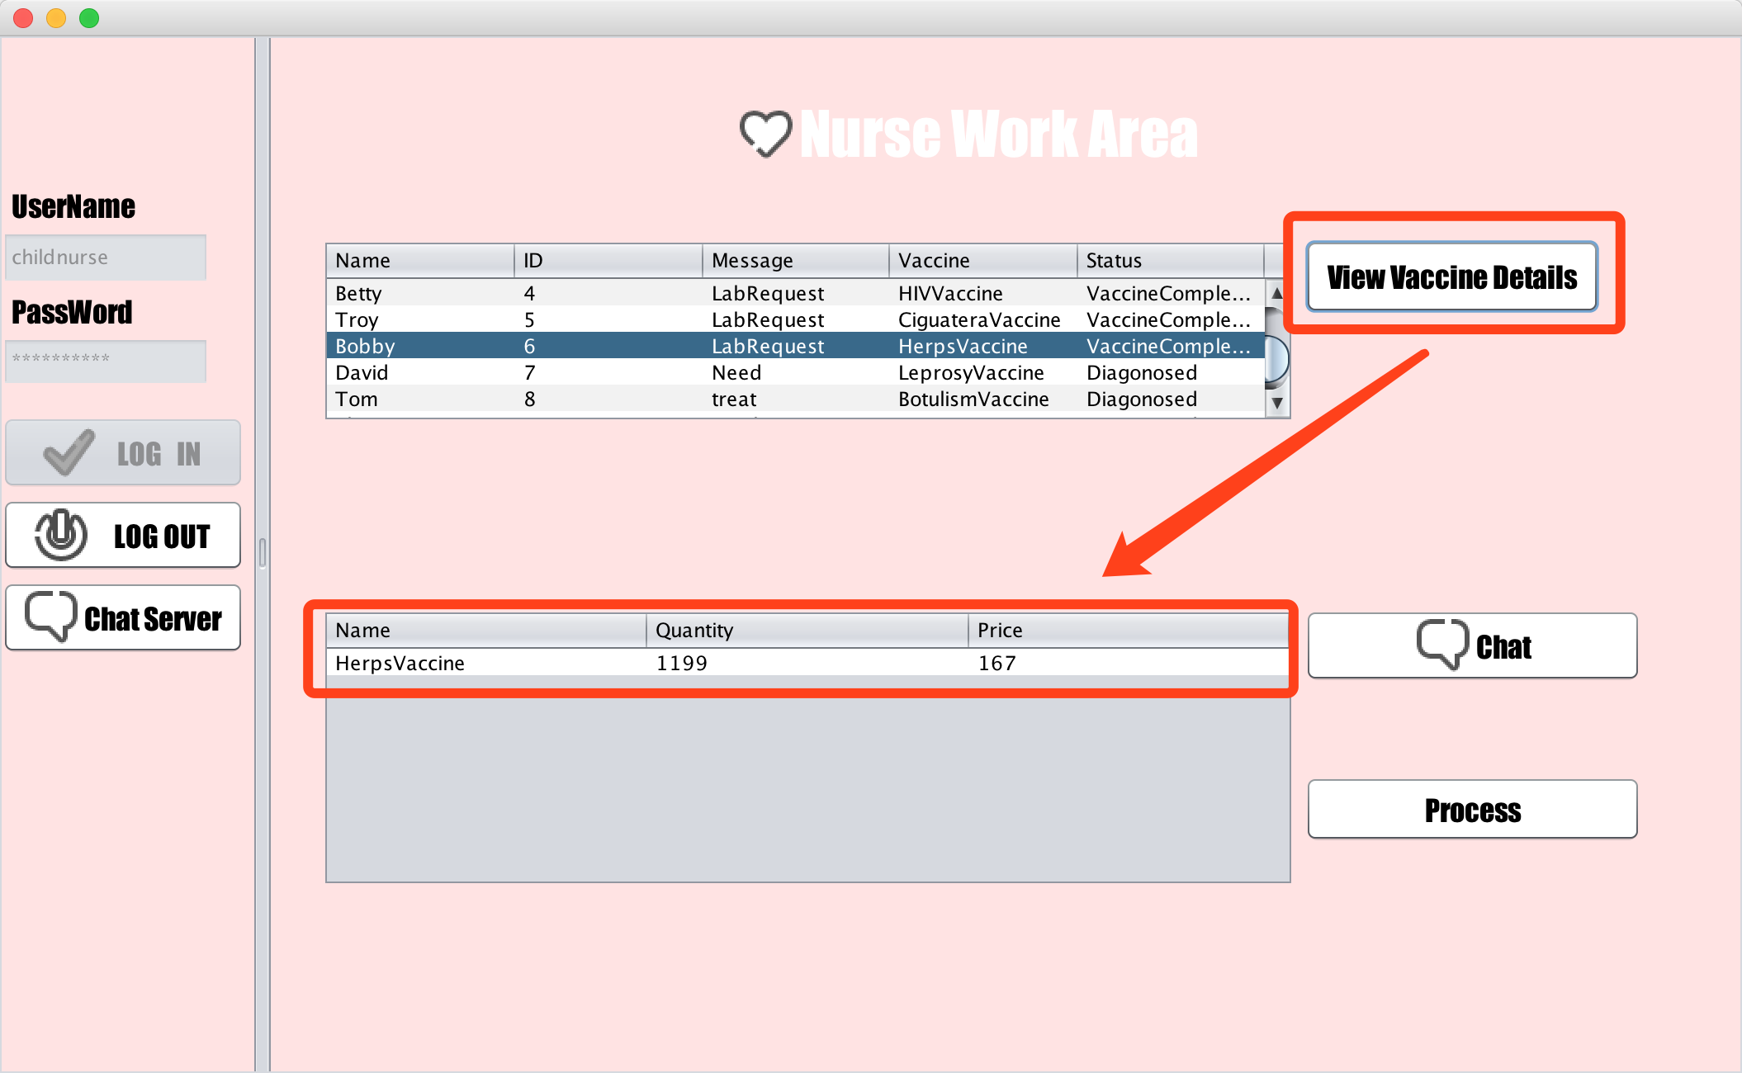
Screen Shots

Slide 57
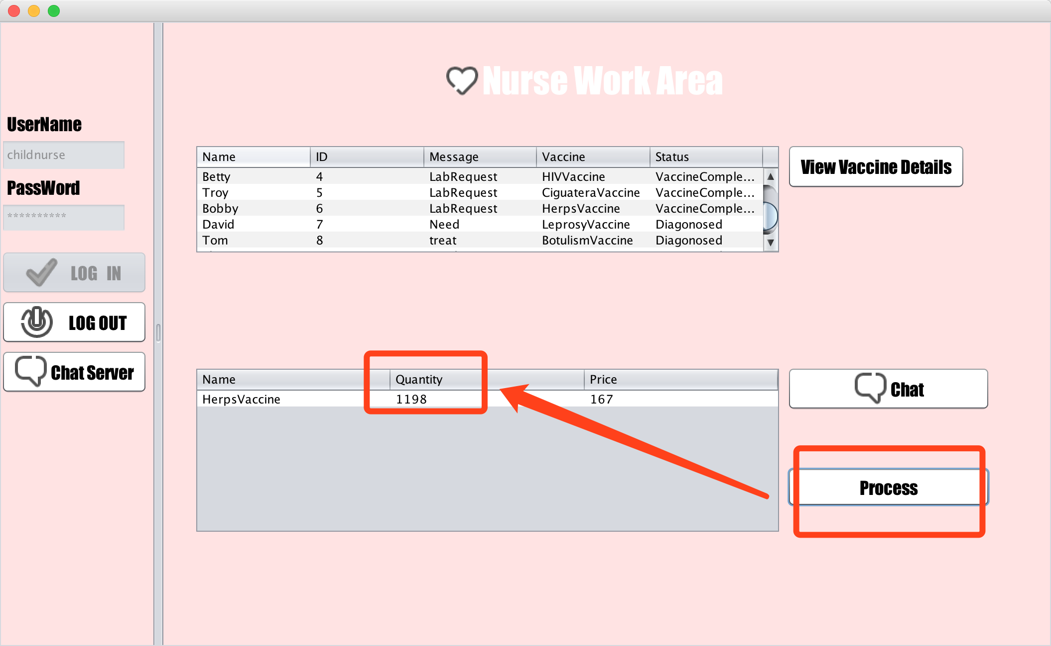
Screen Shots

Slide 58
Screen Shots
Data Analysis Role

Slide 59
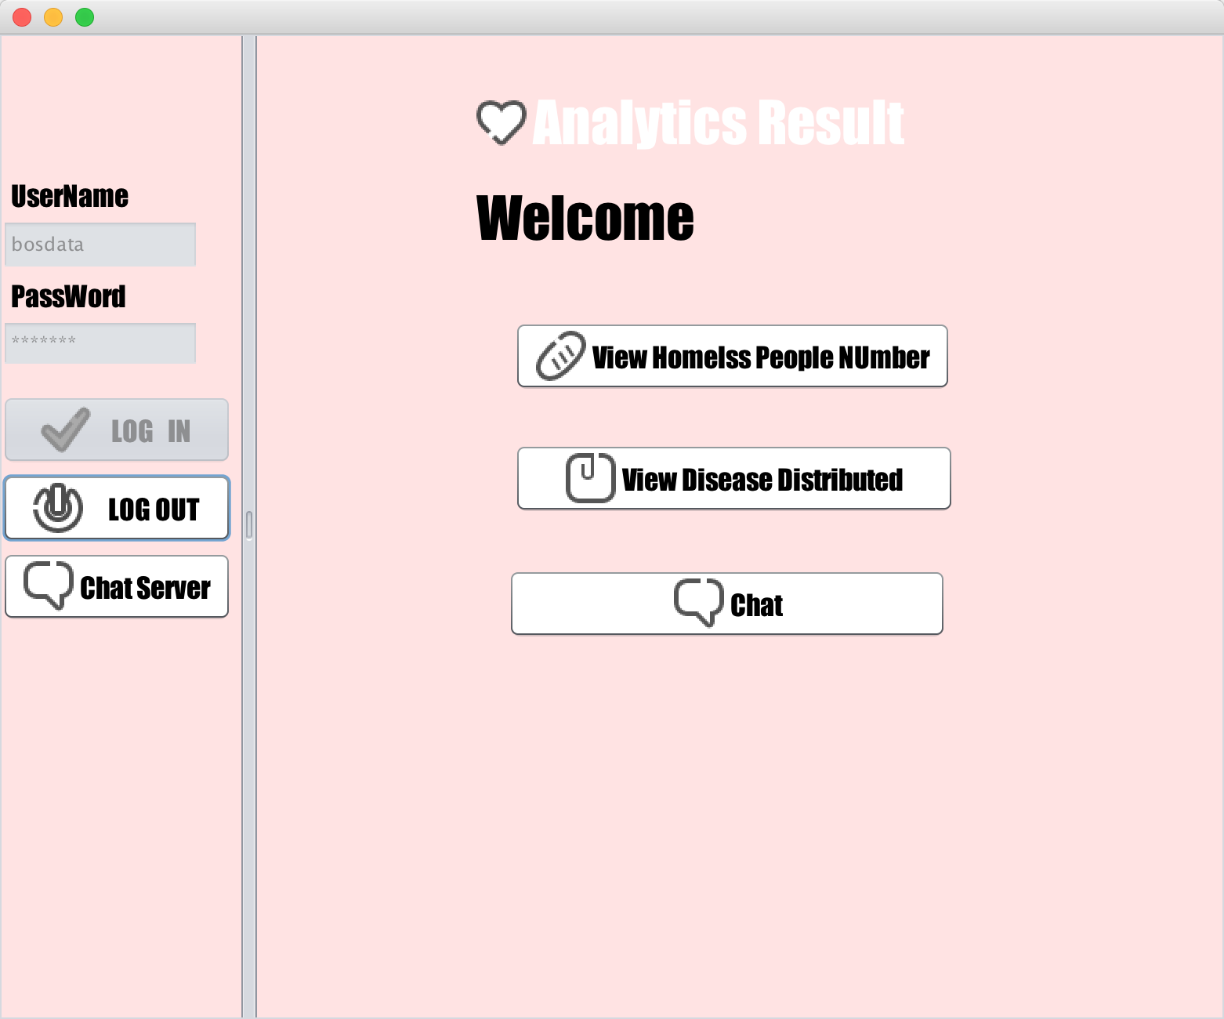
Screen Shots

Slide 60
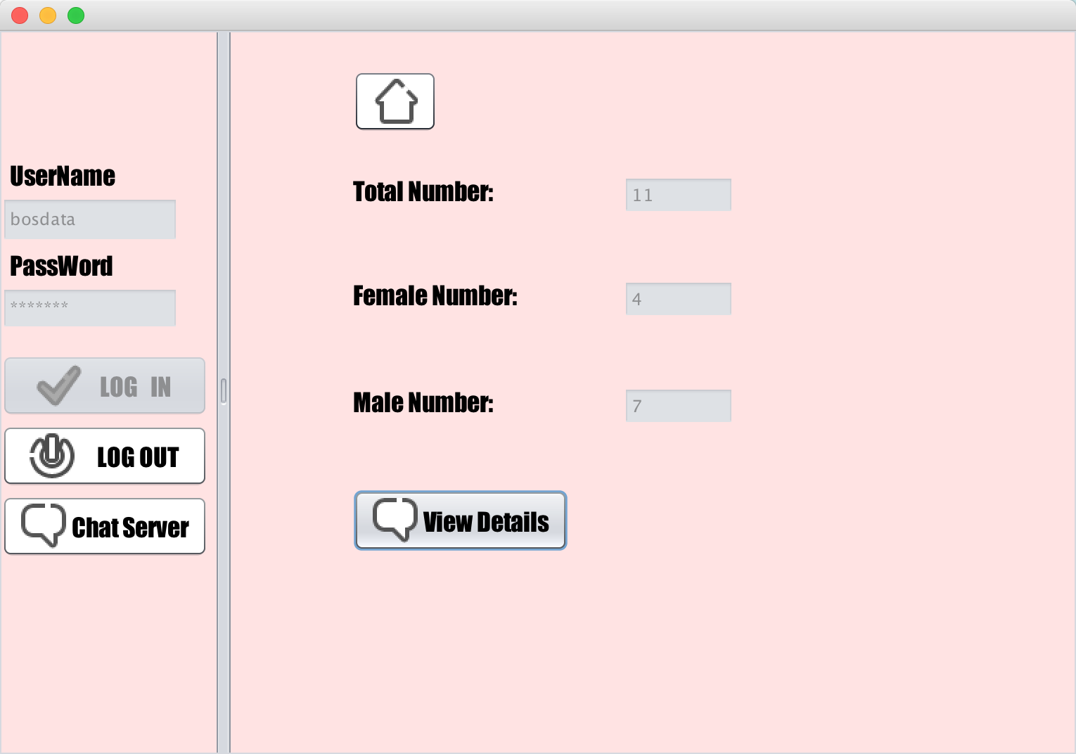
Screen Shots

Slide 61
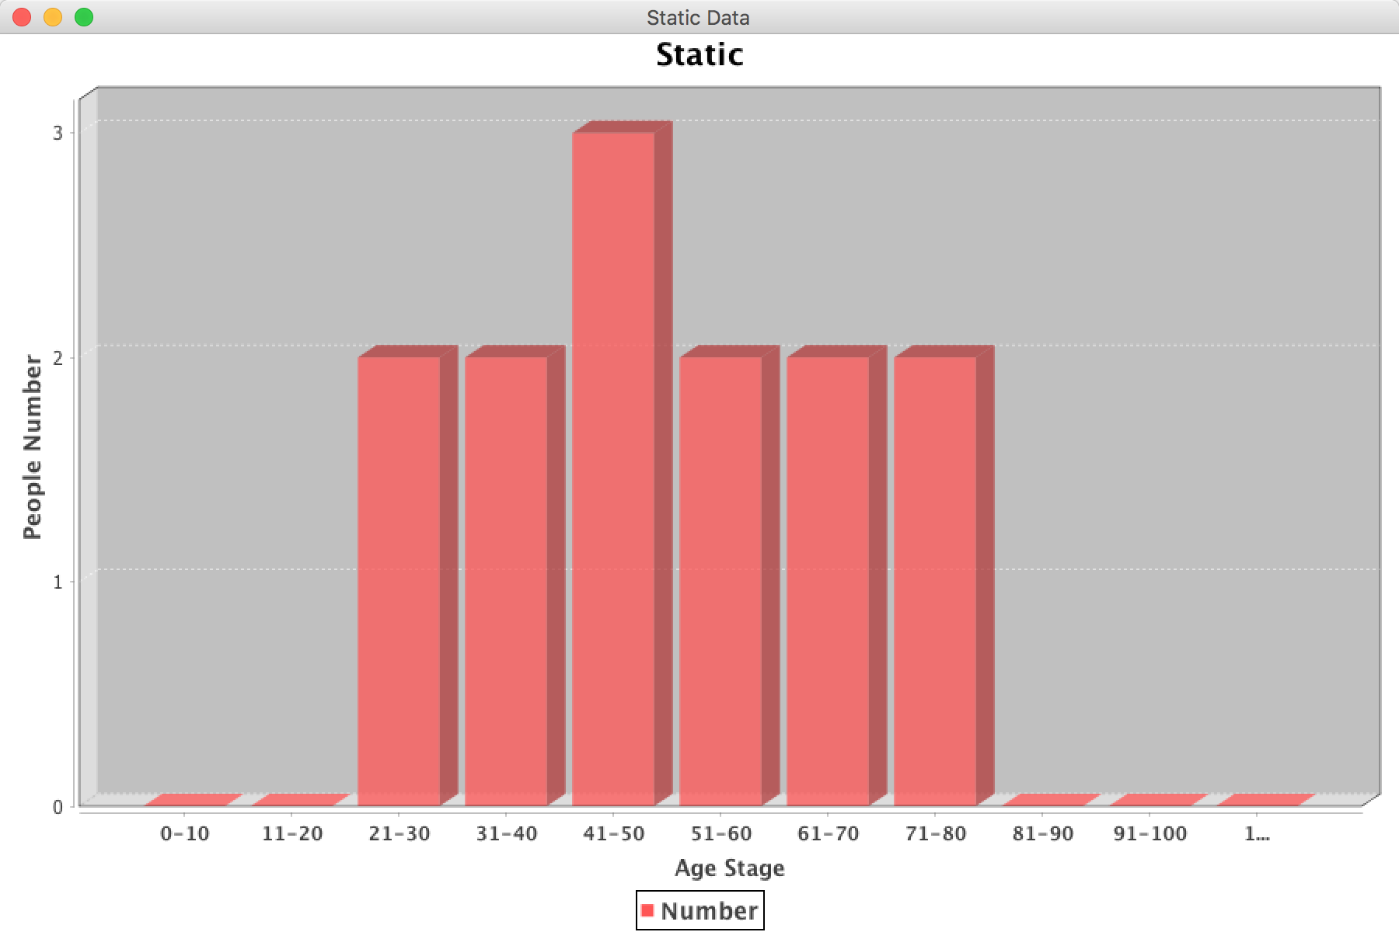
Screen Shots

Slide 62
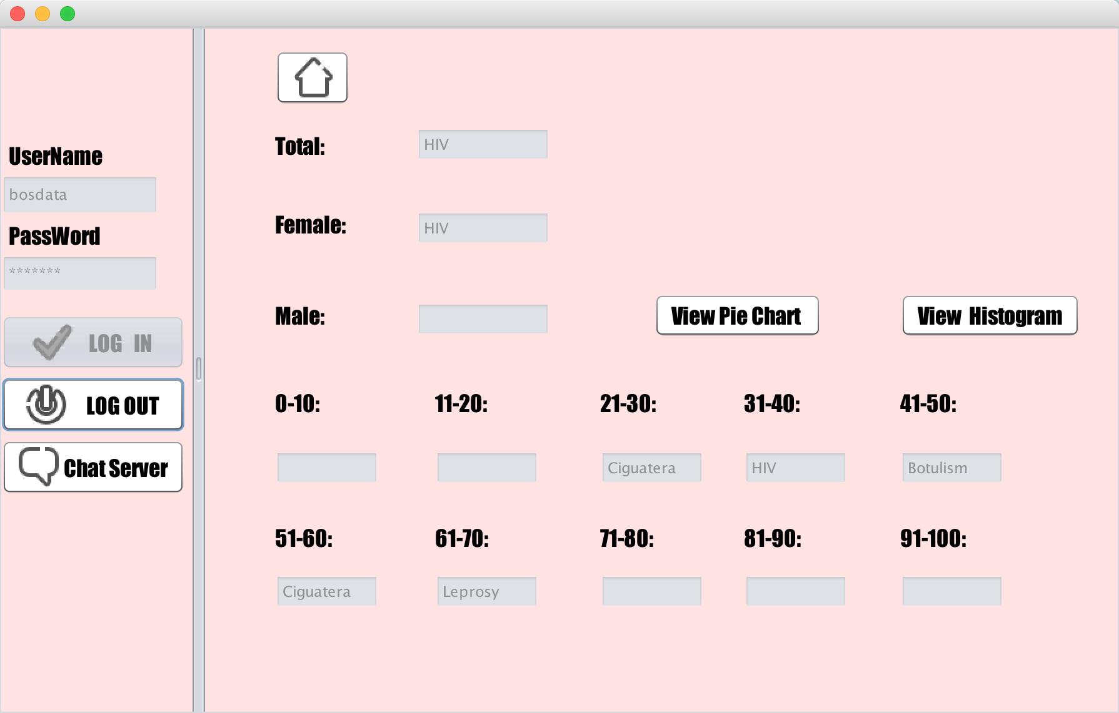
Screen Shots

Slide 63
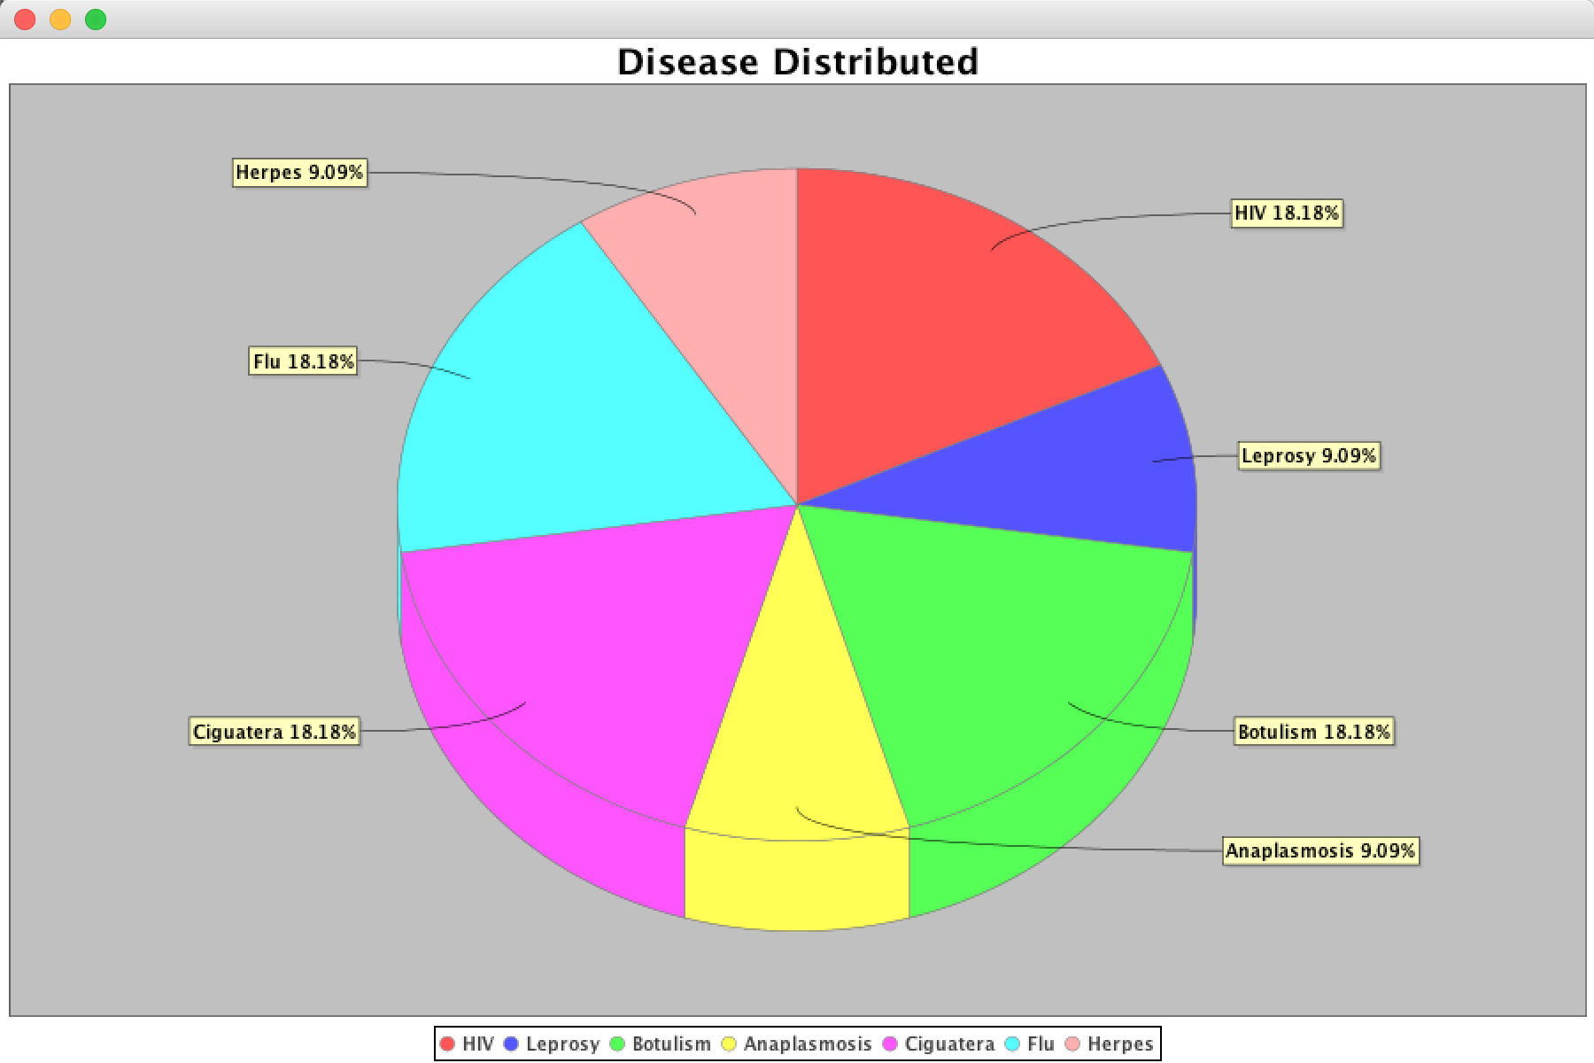
Screen Shots

Slide 64
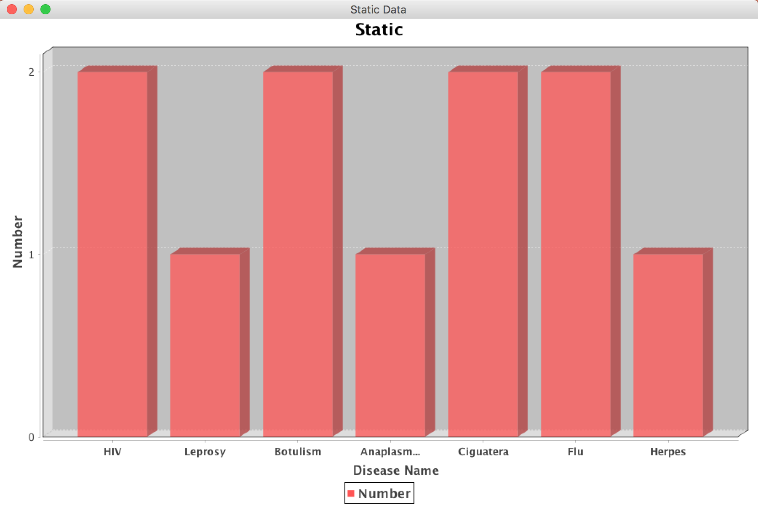
Screen Shots

Slide 65
Screen Shots
Chat Function

Slide 66
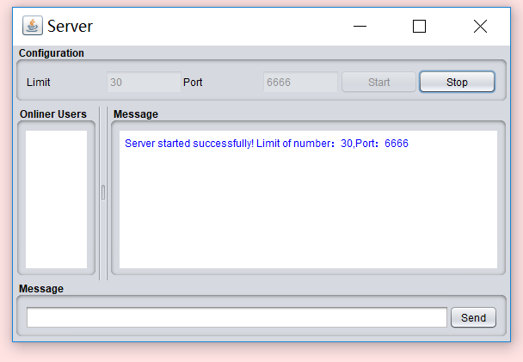
Screen Shots

Slide 67
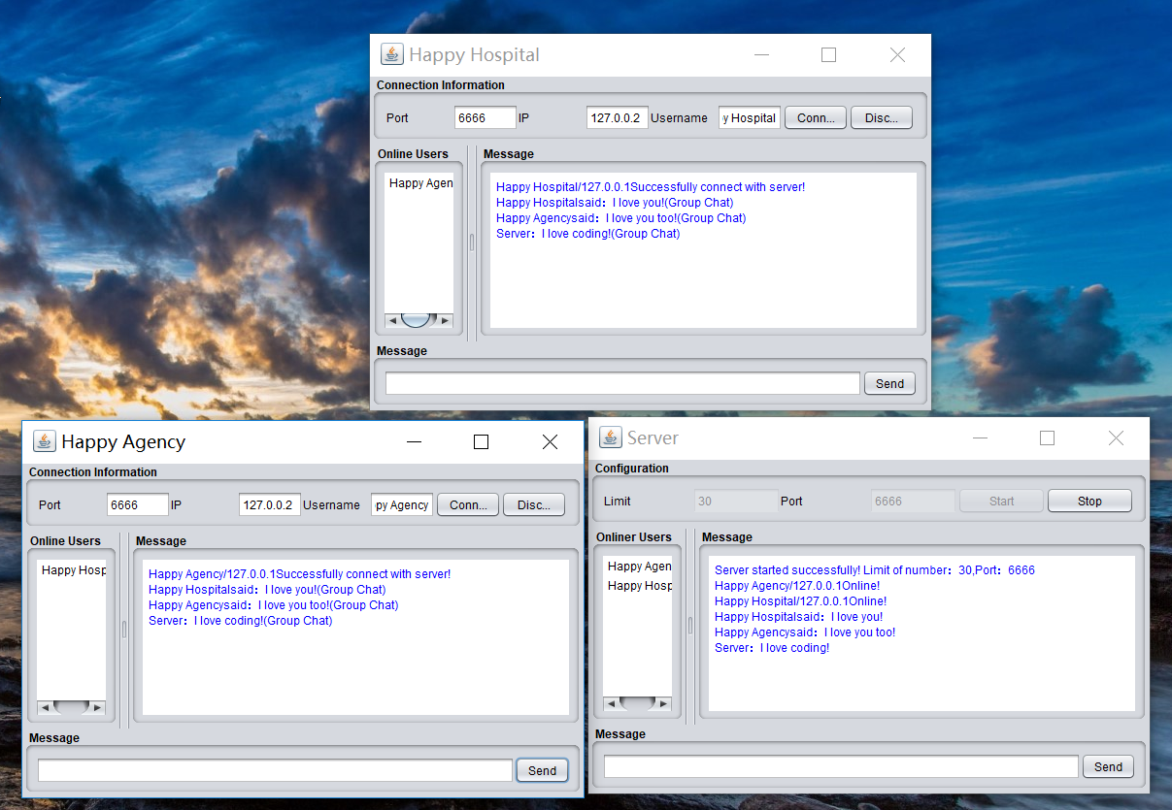
Screen Shots

Slide 68
Thanks For Watching!

